Slide 1

Single-Stage PF LLC Converter
Design with the L6790A — and how it differs from a classic LLC
A beginner-friendly walkthrough: operating principle · design equations · a full 25 V / 26.3 A (657.5 W) worked example
Reference material: L6790A preliminary datasheet · L6790 design spreadsheet r1.0 · EVL6790_670W schematics
Background on the classic LLC: Infineon AN 2013-03 · onsemi / Fairchild AN-4151
Notes:
This deck assumes no prior LLC knowledge. Part 1 builds the classic LLC from scratch, Part 2 shows what single-stage operation changes, Part 3 covers the L6790A itself, Part 4 is the side-by-side comparison, Part 5 a worked example, Part 6 the verification findings.

Slide 2
Agenda
1
What an LLC converter is
symbols, the four blocks, FHA, the gain curve, the three regions, how ZVS works, what breaks off resonance
2
What "single stage PF" changes
no bulk capacitor, topology morphing bridge by bridge, and what the 75 mF output bank costs
3
The L6790A
pins, oscillator, the configuration strap, protections
4
Side by side
a table of every difference that matters
5
Worked example
25 V / 26.3 A = 657.5 W, universal input, step by step
6
Verification & errata
what we re-derived, and what we found wrong
L6790A single-stage PF LLC
Notes:
Roughly 10 minutes per part.

Slide 3






The symbols, once and for all (1/3)
6 of 16 — the tank itself — voltages, turns ratio, and the three reactive parts
bus voltage
What the bridge is fed from. Two-stage: a flat 400 V. Single-stage: the raw rectified mains, sweeping 0 → 373 V, one hundred times a second.
tank drive amplitude
How hard the bridge drives the tank. A full bridge drives with Vᵢₙ, a half bridge with Vᵢₙ/2 — Cᵣ blocks the DC component.
rectifier count and drop
Nrect = 1 for a centre tap, 2 for a secondary full bridge. Vrect is the forward drop of ONE device.
reflected output voltage
Vₒᵤₜ + Nrect · Vrect — what the secondary looks like once the rectifier drops are added in.
turns ratio
It only ever appears multiplied by Vo,eff. That product is the voltage the secondary reflects back to the primary side.
tank voltage gain
(voltage the tank hands to the transformer) ÷ (voltage the bridge applies). M = 1 at the series resonance, for any load.
L6790A single-stage PF LLC

Slide 4






The symbols, once and for all (2/3)
6 of 16 — gain, the two design knobs, and the two resonances
series resonant pair
The series arm of the tank. Together they fix the series resonance fᵣ and the impedance scale Z₀.
magnetising inductance
The shunt arm. Its current never reaches the load — it is what discharges the MOSFET output capacitance and buys ZVS.
inductance ratio — the SHAPE knob
Bigger λ = a taller, steeper gain curve = more boost available, but also more circulating current. A single stage lands near 0.5.
the same knob, inverted
m = 1 + 1/λ. Application notes quote m, this deck quotes λ. m = 3…8 is the classic range; a single stage needs about 2.9.
the two resonances
fᵣ is Cᵣ with Lᵣ alone (secondary conducting). fₒ is Cᵣ with Lᵣ + Lₘ (no load). fₒ is the FREQUENCY FLOOR.
normalised frequency
1 means "at resonance". Below 1 the tank boosts, above 1 it bucks. The floor sits at fₙ₀ = fₒ/fᵣ.
L6790A single-stage PF LLC

Slide 5




The symbols, once and for all (3/3)
4 of 16 — loading — and the one variable that only exists in a single-stage design
equivalent ac load
Rectifier, transformer and load collapsed into ONE resistor, so the tank becomes a plain RLC divider.
characteristic impedance
The tank’s own impedance scale, in ohms. It does not depend on the load at all.
quality factor
HOW HEAVILY the tank is loaded. Q → 0 is no load (a tall, peaky curve); large Q is full load (a low, flat curve).
line phase angle
0 at the mains zero crossing, 90° at the mains peak. In a single-stage design EVERY quantity is a function of θ.
L6790A single-stage PF LLC

Slide 6
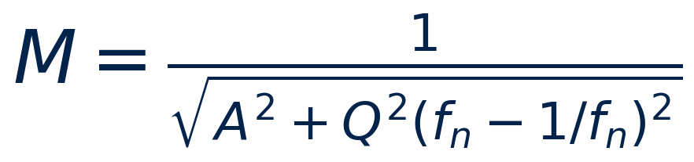
Reading the gain equation term by term
One equation carries the whole LLC. Here is what each piece does.
A(fₙ) = 1 + λ − λ/fₙ² — the SHAPE
Q²(fₙ − 1/fₙ)² — the LOADING
A carries no load information at all. It becomes ZERO at fₙ₀ = √(λ/(1+λ)); with no load that is where M blows up. That singularity IS fₒ, the frequency floor. At fₙ = 1 we get A = 1, hence M = 1 at resonance.
Zero at fₙ = 1, growing on both sides. This is what DAMPS the peak: heavier load = bigger Q = lower, flatter curve. It is also why FULL LOAD is the worst case for the tank design.
λ decides WHERE the pole sits and how tall the curve can be. Q decides HOW MUCH of that height the load lets you keep. Those two numbers are the only degrees of freedom in the entire tank.
L6790A single-stage PF LLC

Slide 7
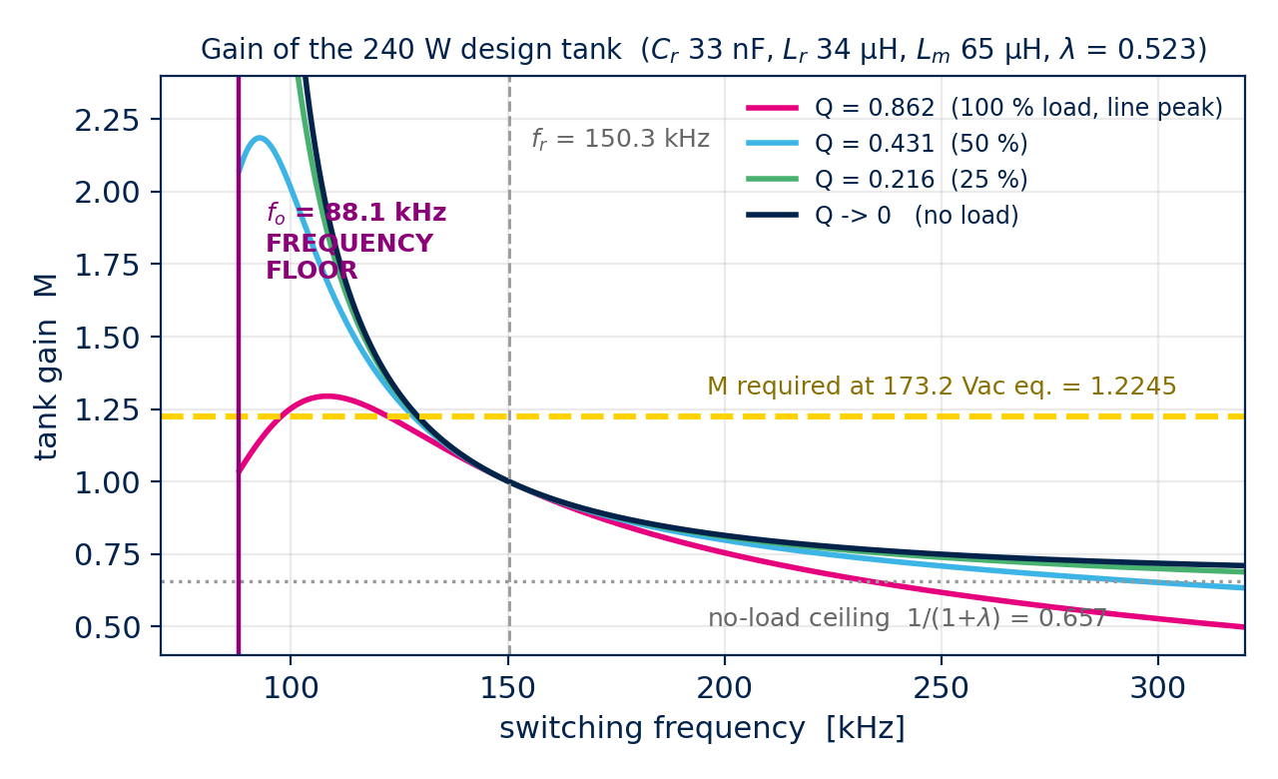
Two resonances, and why the lower one matters
Every LLC has fᵣ and fₒ. The single-stage converter lives near fₒ.
fᵣ : Cᵣ resonates with Lᵣ alone. This happens when the secondary is conducting, so Lₘ is clamped by the reflected output voltage and drops out of the circuit. At fᵣ the gain is 1 for ANY load — the load term vanishes.
fₒ : Cᵣ resonates with Lᵣ + Lₘ. This happens at NO load, when nothing clamps Lₘ. At fₒ the no-load gain is infinite — so nothing can push the converter below fₒ.
Every operating point sits between fₒ and infinity. Below fₒ the tank turns capacitive and the bridge hard-switches.
In this design fₒ = 90.4 kHz and fᵣ = 151.7 kHz. That whole band is where a single-stage converter spends most of the line cycle.
L6790A single-stage PF LLC

Slide 8
PART 1
What an LLC converter is
Everything in this part is the CLASSIC, two-stage LLC. If you already know it, skip to Part 2 — but note the numbers, because Part 4 compares against them.

Slide 9
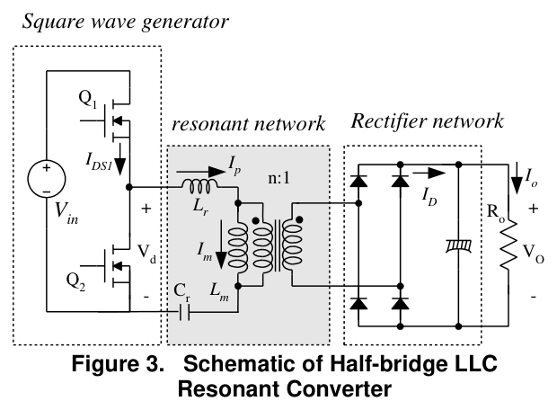
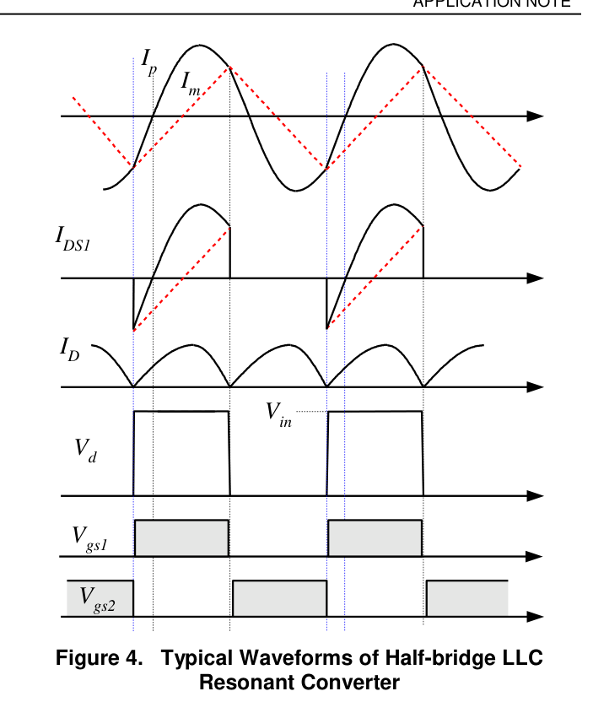
The LLC in four blocks
A square-wave generator, a resonant tank, a transformer, a rectifier
Remember this
Only the FREQUENCY is available as a control handle. The height of the square wave is whatever the bus happens to be.
Q1/Q2 chop the DC bus into a square wave at 50 % duty. Only the FREQUENCY can be changed — never the height.
The tank (Lᵣ, Cᵣ, Lₘ) filters that square wave down to (almost) a pure sine. It also decides how much voltage reaches the transformer.
Lₘ is small on purpose — 3 to 8 times Lᵣ — so a large magnetising current circulates. That current is what discharges the MOSFET output capacitance and gives ZVS.
The rectifier restores DC. Centre-tap or full bridge, diodes or synchronous MOSFETs.
Figures: onsemi / Fairchild AN-4151, Fig. 3 and Fig. 4
L6790A single-stage PF LLC
Notes:
The single most important sentence: only frequency is available as a control handle.

Slide 10
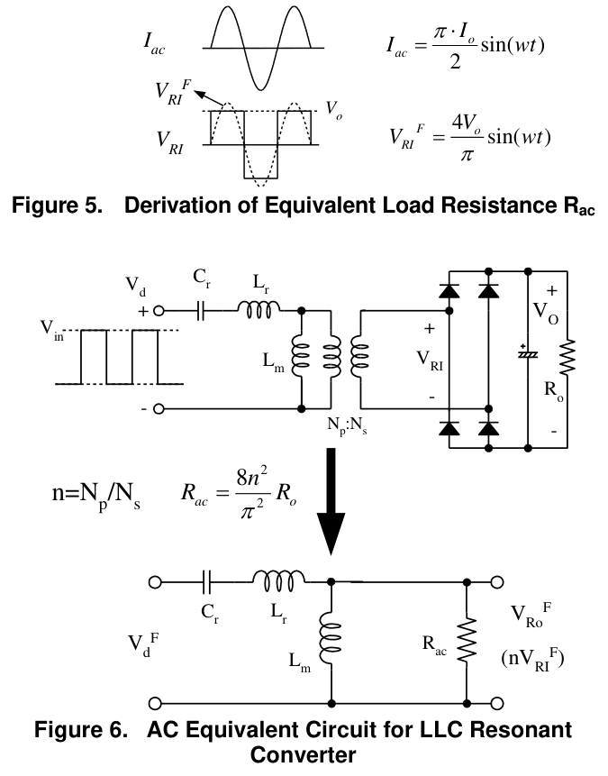
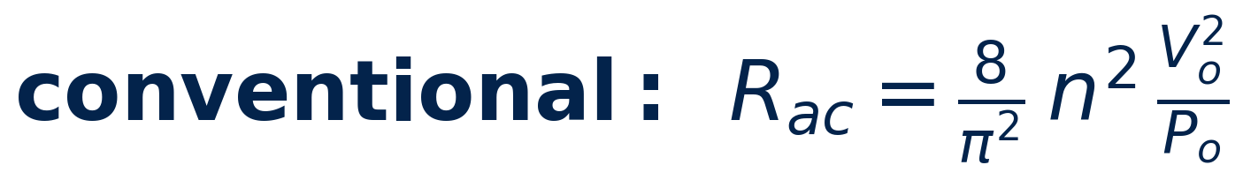
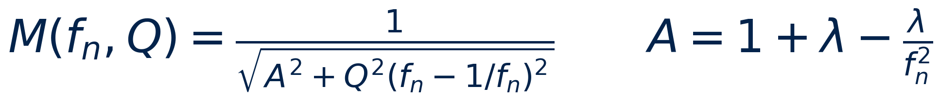
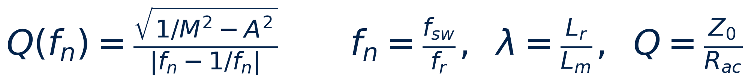
First-harmonic approximation (FHA)
Replace everything after the tank by one resistor, then it is just an RLC divider
The load, rectifier and transformer collapse into one equivalent resistance:
and the tank becomes a frequency-dependent divider whose gain is:
Two numbers describe the whole tank: λ is the SHAPE, Q is the LOADING. Next slide takes them apart.
Figure: onsemi / Fairchild AN-4151, Fig. 5 and Fig. 6
L6790A single-stage PF LLC

Slide 11
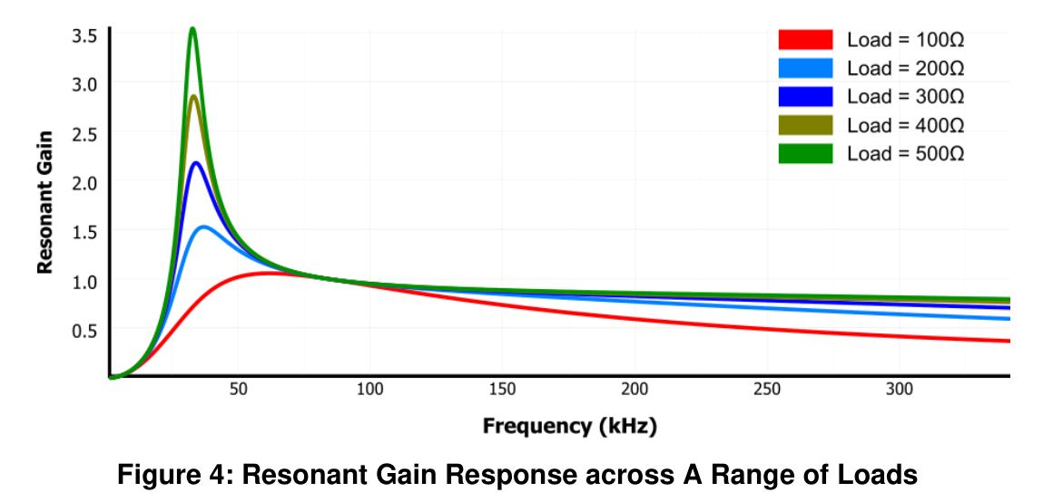
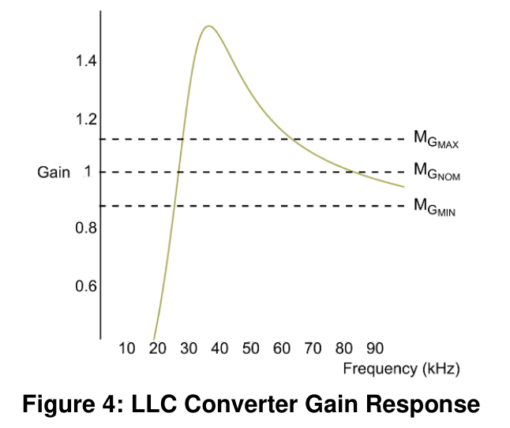
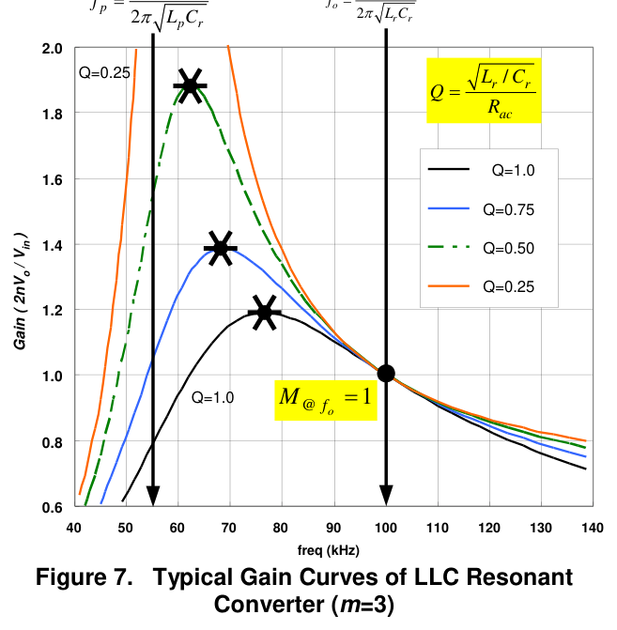
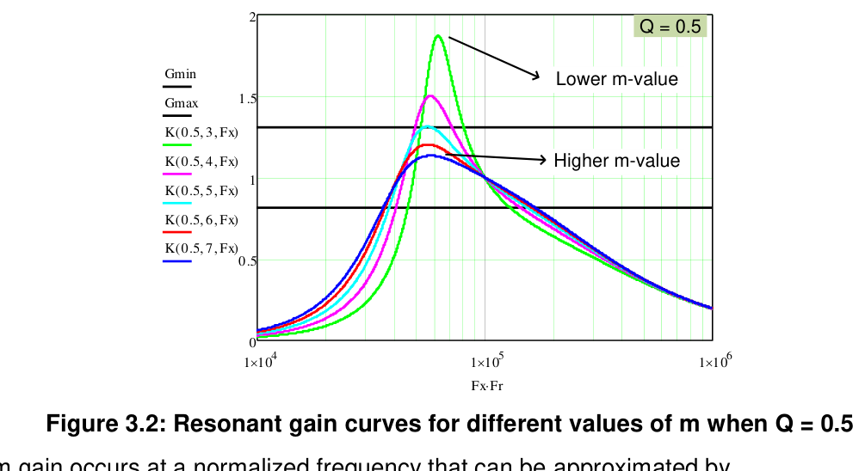
The gain curve
Gain is 1 at resonance, boosts below it, bucks above it
Light load (small Q) → tall, peaky curve → lots of boost available.
Heavy load (large Q) → flat curve → the peak gain DROPS. Full load is therefore the worst case for the tank design.
Smaller m = Lp/Lr (i.e. larger λ) raises the whole curve, at the price of more circulating current.
Figures: MPS article A-0028 Fig. 4 (left) · A-0029 Fig. 4 (right), Monolithic Power Systems, "Understanding LLC Operation" (2022)
L6790A single-stage PF LLC

Slide 12
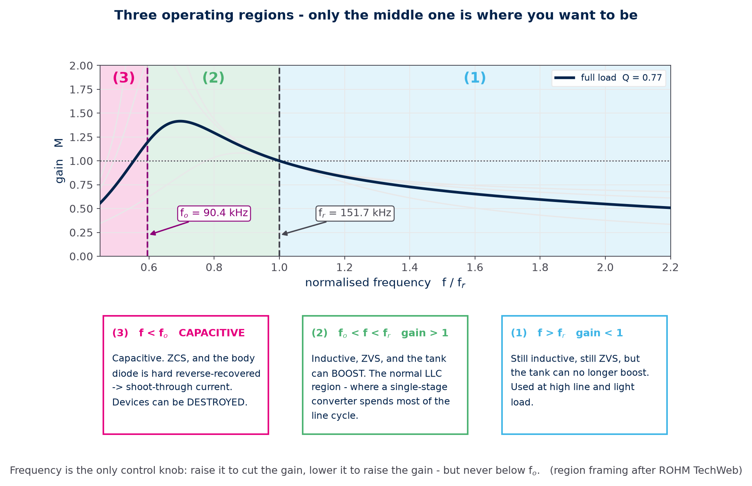
Three operating regions
One map for everything that follows — only the middle region is where you want to be
Read it this way
Pick a frequency, read the gain.
Raise f to cut the gain, lower f
to raise it — but never below fₒ.
Where we live
A single-stage converter spends
most of the line cycle in (2),
and runs down towards fₒ near
the zero crossing.
The one to avoid
Region (3). Not "worse
efficiency" — device destruction.
Figure: generated by figs.py from l6790.py · region framing after ROHM TechWeb LLC series
L6790A single-stage PF LLC

Slide 13
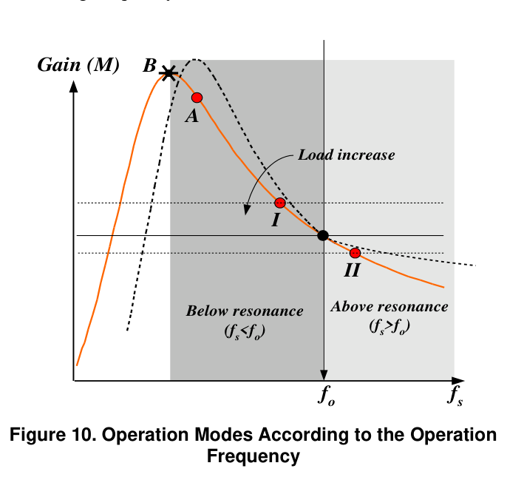
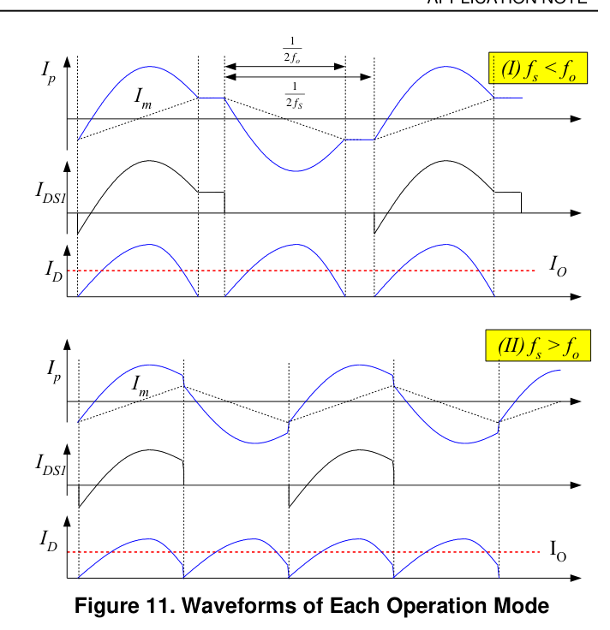
Below or above resonance?
Both work — they trade rectifier losses against circulating current
Below resonance (fsw < fr)
Above resonance (fsw > fr)
Secondary current is a half-sine that reaches zero before the half period ends → rectifier turns off at ZERO CURRENT. But the circulating current is large.
Minimum circulating current, best conduction loss. But the rectifier is hard-commutated, and light load pushes the frequency very high.
Figures: onsemi / Fairchild AN-4151, Fig. 10 and Fig. 11
L6790A single-stage PF LLC

Slide 14
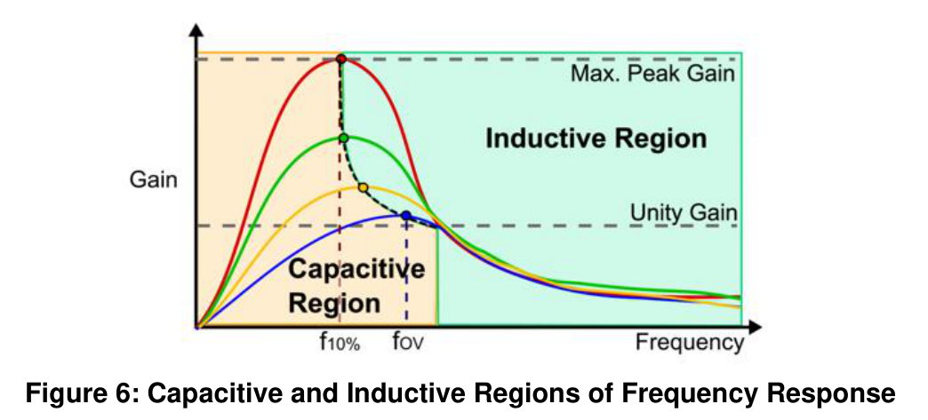
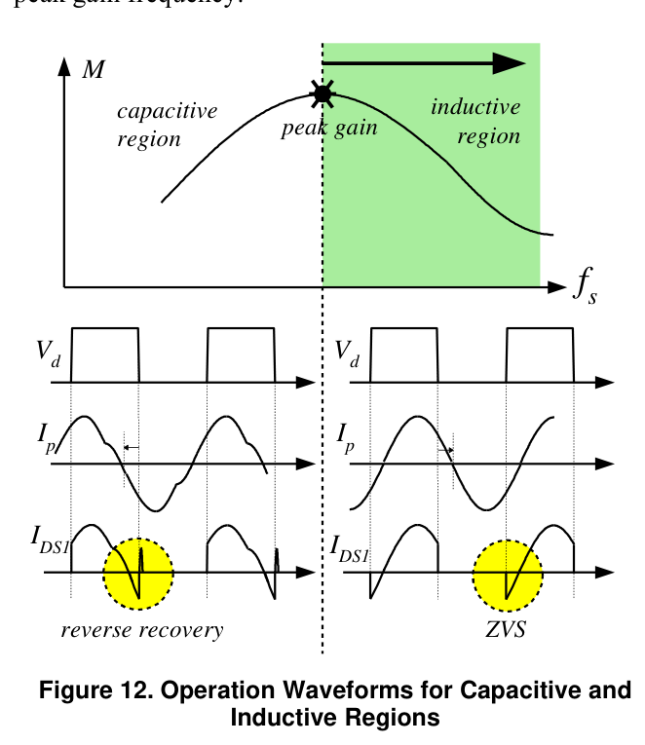
ZVS and the forbidden capacitive region
Stay on the inductive side of the gain peak — always
INDUCTIVE side (right of the gain peak): the tank current LAGS the square wave. During the dead time it keeps flowing and pulls the midpoint to the next rail — the MOSFET turns on at zero volts. This is ZVS.
CAPACITIVE side (left of the peak): the current LEADS. The body diode is hard reverse-recovered, the noise is violent, and the gain slope reverses so the output goes out of control.
The minimum switching frequency must therefore be clamped WELL above the peak-gain frequency.
Practical rule from both application notes: leave 10–20 % margin on the maximum gain so that ZVS survives load steps and start-up.
Figure: MPS article A-0029 Fig. 6, Monolithic Power Systems, "What to Consider in LLC Converter Design" (2022)
L6790A single-stage PF LLC

Slide 15
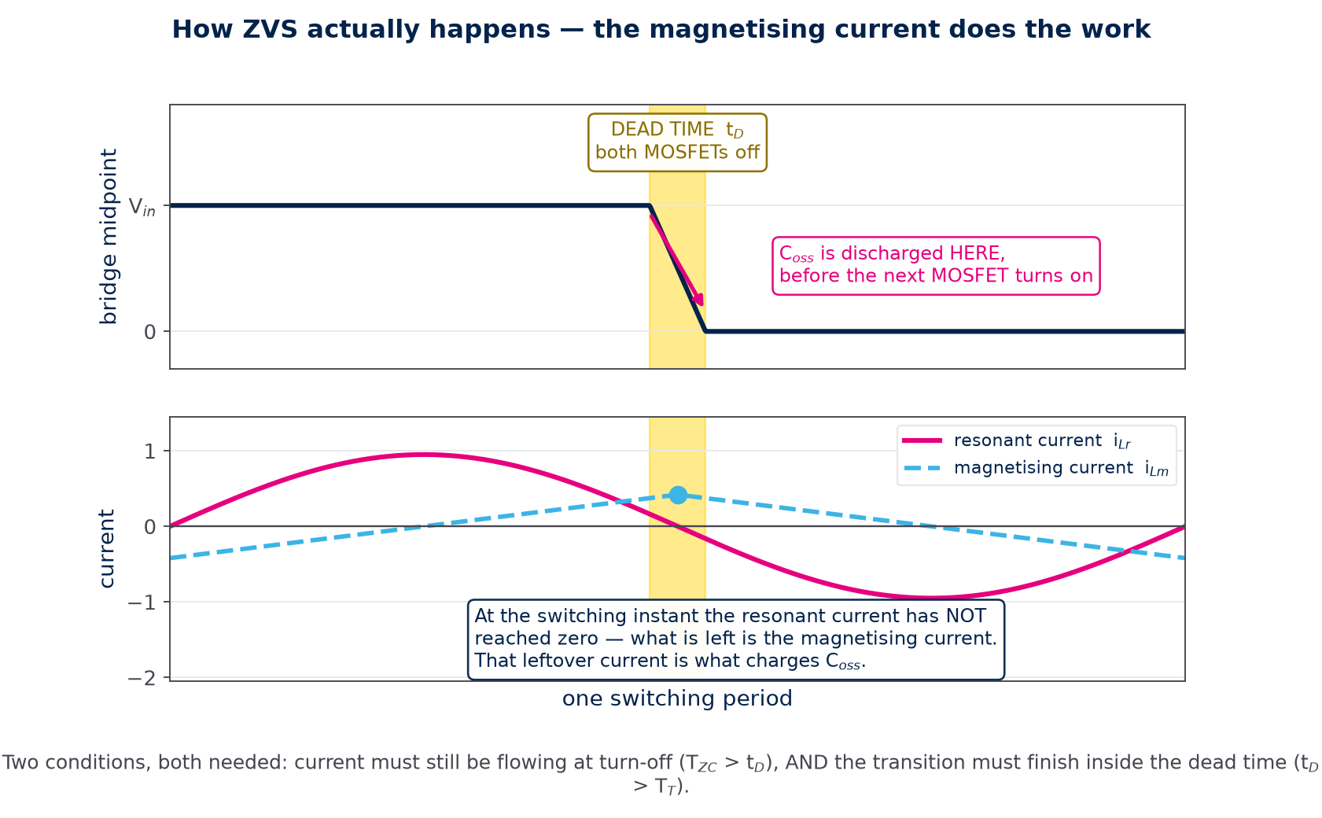
How ZVS actually happens
The magnetising current does the work — during the dead time, not during conduction
The sequence
1 MOSFET turns off.
2 Dead time: BOTH off.
3 The current still flowing
discharges Cₒₛₛ of the
device about to turn on.
4 It turns on at 0 V.
Two conditions
Tᴢᴄ > tₔ current is still
flowing at turn-off
tₔ > Tₜ the swing finishes
inside the dead time
Figure: generated by figs.py · mechanism after ROHM TechWeb, "Features of LLC Converter Operation"
L6790A single-stage PF LLC

Slide 16
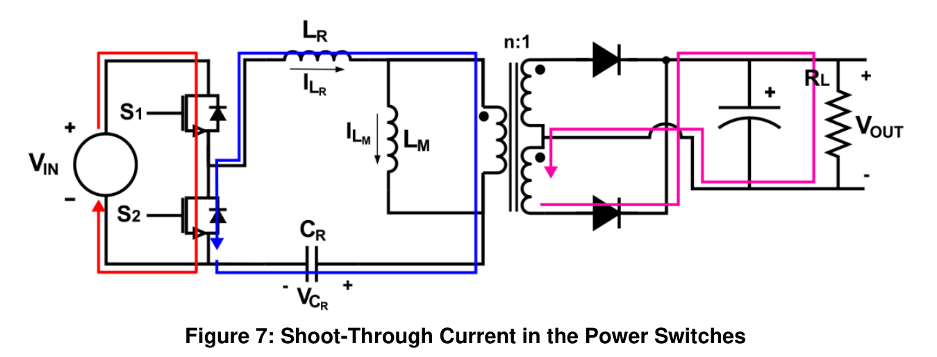
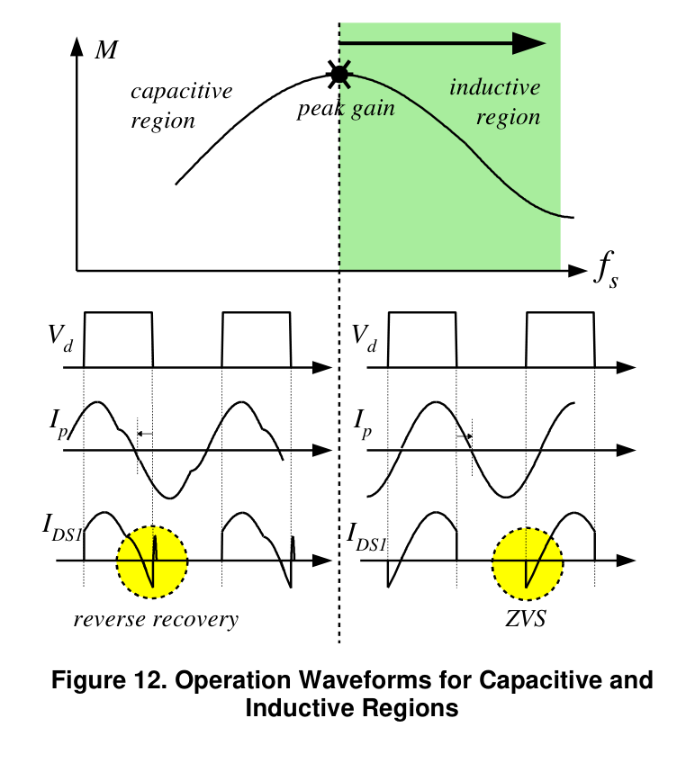
What goes wrong off resonance
The body diode is the part that fails — and it decides which MOSFET you may use
Why it happens
Below fₒ the tank is capacitive, so the current LEADS the voltage.
The MOSFET is then turned on while its BODY DIODE is conducting.
The diode has to reverse-recover, and during that recovery both
devices conduct — a shoot-through current straight across the bus.
When it happens
Not only by bad design: overload, a load step, low line, and
START-UP all push the converter off resonance for a few cycles.
Design rule — pick a primary MOSFET whose BODY DIODE has fast recovery. It is not a secondary parameter here: it decides whether an inevitable off-resonance excursion costs a few extra watts or the device.
Figure: MPS article A-0029 Fig. 7 · mechanism after ROHM TechWeb, "Importance of MOSFET Recovery Characteristics"
L6790A single-stage PF LLC

Slide 17
The classic design recipe
Both Infineon and onsemi follow the same eleven steps
Step | What you do | onsemi AN-4151 / Infineon AN 2013-03
1–2 | specification, efficiency, gain range | Mmin at Vin,max, Mmax at Vin,min (+10–20 % margin)
3 | turns ratio | n = Vin,max /(2(Vₒ+V_F)) × Mmin
4 | equivalent load | Rac = 8n²Vₒ²/(π²Pₒ)
5 | pick m (or λ), read Q from the peak-gain chart | m = 3…8 → gain 1.1…1.2 at resonance
6 | resonant components | Cr = 1/(2π Q fₒ Rac), Lr = 1/((2πfₒ)²Cr), Lp = m·Lr
7–8 | transformer turns / core, resonant capacitor rating | Nₚ from ΔB; Cr voltage from the OCP trip point
9–10 | rectifier, output capacitor, control circuit | V_D = 2(Vₒ+V_F); RT/soft-start network
11 | current sensing and protection | R_sense from the OCP threshold
Keep this list in mind. In Part 4 we will walk it again and mark every step that a single-stage converter changes.
L6790A single-stage PF LLC

Slide 18
PART 2
What "single stage PF" changes
Remove the boost PFC and the 400 V bulk capacitor. Everything you just learned still applies — but the ROLE of the switching frequency changes completely.

Slide 19
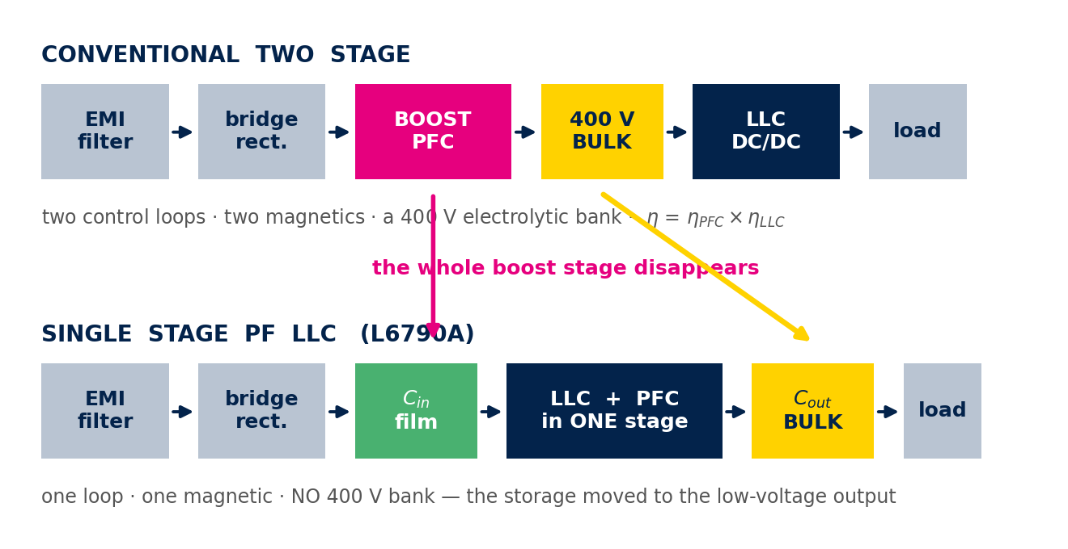
Two stages, or one
The boost stage and the 400 V bank both disappear
What you gain
What you pay
Where it fits
One stage instead of two: fewer parts, no 400 V electrolytic bank, one control loop, no product of two efficiencies.
The tank must cover the whole mains range, λ must be large, circulating current is high, and the output carries a 2fl ripple.
LED drivers, LCD TV, AIO PC, server and telecom front ends, USB-PD — anywhere a few % of 100/120 Hz ripple is fine.
L6790A single-stage PF LLC

Slide 20
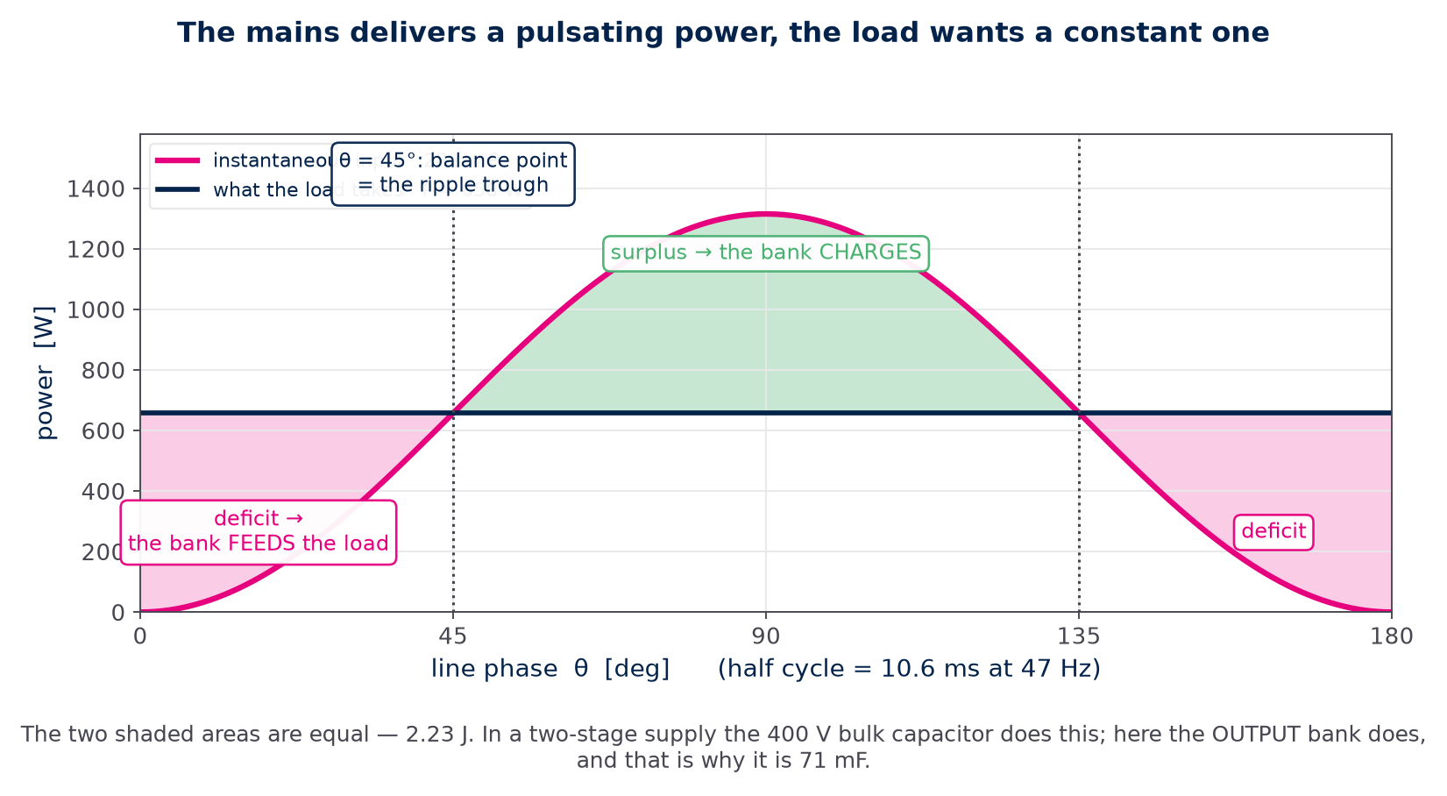
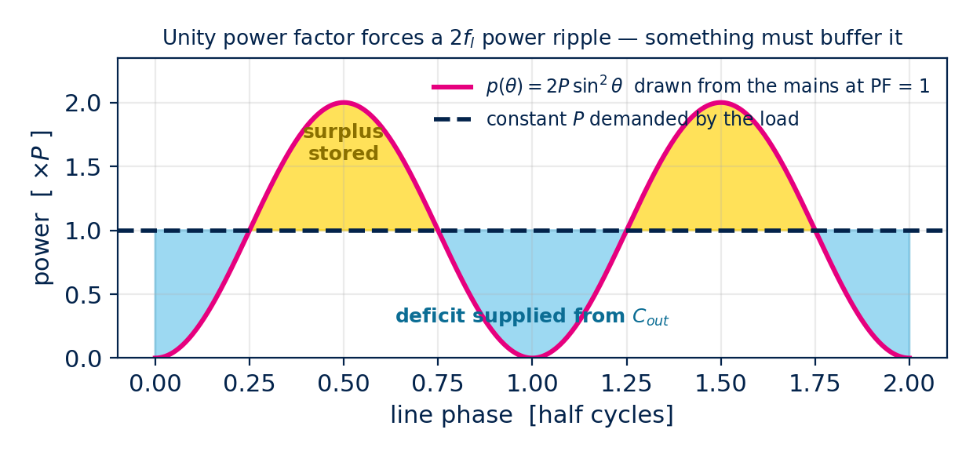
Why unity power factor forces a ripple
The mains delivers 2P sin²θ — the load wants a constant P
Where does the difference go?
In a two-stage supply the 400 V
bulk capacitor stores it.
In a single stage there is no bulk
capacitor — so the OUTPUT
capacitor does the job instead.
What it costs
The energy moved from 400 V to
25 V, and energy goes as C·V² —
so the bank is 75 mF.
Everything is sized at 2·P, not P:
peak power 2P, peak current 2I.
Figure: generated by figs.py from l6790.py — 25 V / 657.5 W design
L6790A single-stage PF LLC

Slide 21
Gain is no longer a control variable
Both ports are voltage sources — so the gain is FORCED from outside
In a classic LLC you change the frequency to change the gain, and the gain sets Vₒᵤₜ. Here that reasoning breaks:
The output is a voltage source
The input is a voltage source too
Cₒᵤₜ is in the millifarad range, so Vₒᵤₜ simply cannot move inside one 10 ms line half cycle.
There is no bulk capacitor, so the bus IS the rectified mains, |v_ac(θ)| — a sine, every cycle.
M is already decided at every instant. Feed it back into the FHA gain equation and solve — what the frequency actually sets is Q, and Q is the load. In other words: THE FREQUENCY SETS POWER, NOT VOLTAGE.
L6790A single-stage PF LLC
Notes:
This is the single most important slide in the deck.

Slide 22
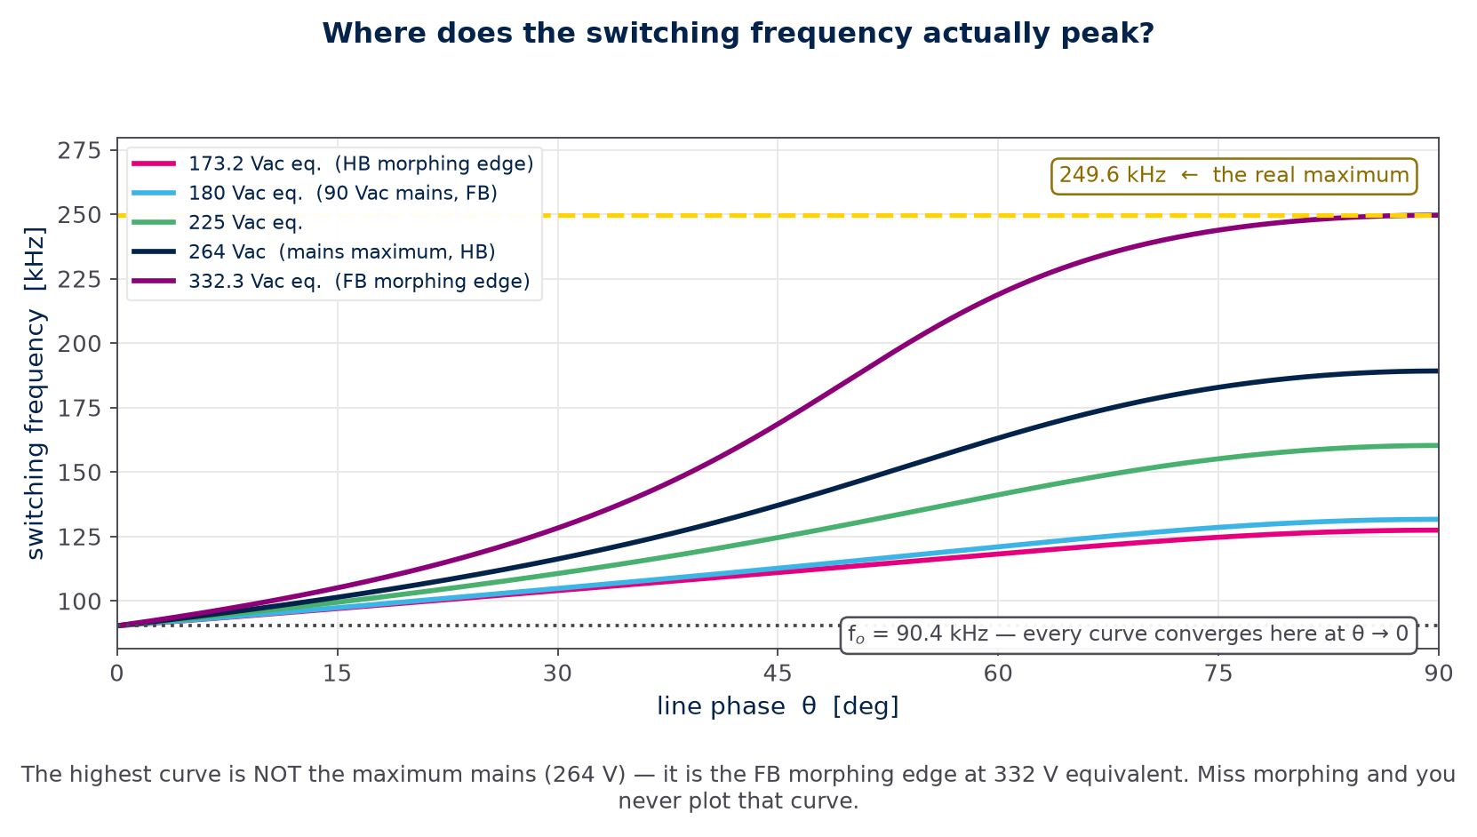
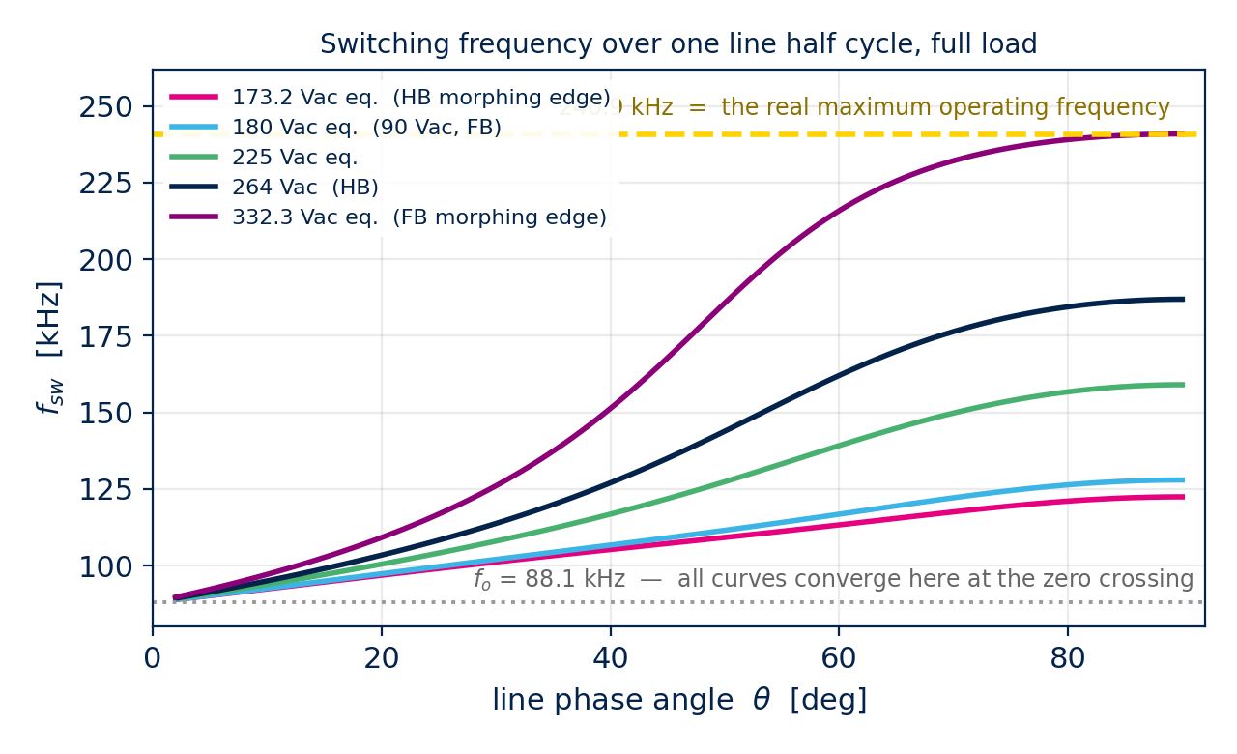
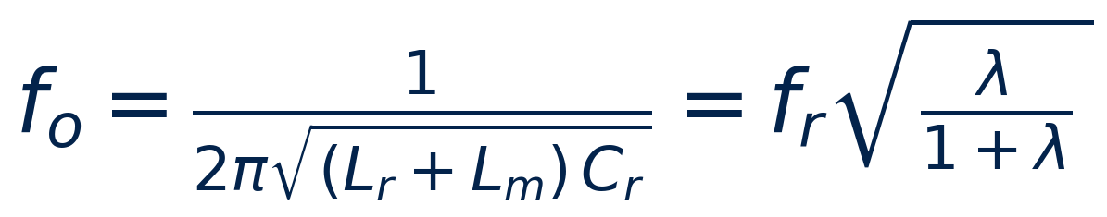
Frequency modulation IS the power factor correction
Follow 2P sin²θ and the input current becomes a sine in phase with the voltage
How to read it
One curve per equivalent input
voltage, over one line half cycle.
At each phase θ the gain M and
the load Q are both known, so
f_sw follows from the tank.
The point
The highest curve is the FB
morphing edge — NOT the
maximum mains.
Miss morphing and you never
plot it.
Figure: generated by figs.py from l6790.py
L6790A single-stage PF LLC

Slide 23
How does an LLC do power factor correction at all?
Six steps. Follow them once and the whole topology falls out.
1
What PFC actually demands
Nothing about voltage. It says the INPUT CURRENT must be a sine in phase with the mains. Multiply the two and you get the instantaneous power the converter must draw: p(θ) = 2P sin²θ.
2
What the LLC can control
Only frequency. The bridge is a fixed 50 % square wave; its height is the mains, which you cannot touch. So frequency is the one and only actuator.
3
What frequency normally does
In a classic LLC it changes the GAIN, and the gain sets Vₒᵤₜ. That path is closed here, because both ends of the converter are already voltage sources.
4
So the gain is forced
Cₒᵤₜ is millifarads → Vₒᵤₜ cannot move within a line half cycle. No bulk capacitor → the bus IS |v_ac(θ)|. Both ends fixed ⇒ M(θ) is fixed, instant by instant.
5
Which leaves Q
Put the forced M(θ) back into the gain equation and solve for fₙ. The only free variable left in that equation is Q — and Q is the load, i.e. the POWER.
6
Therefore frequency = power
Sweep fsw over the line half cycle so that the delivered power follows 2P sin²θ, and the input current becomes the sine PFC asked for in step 1. That IS the power factor correction.
L6790A single-stage PF LLC

Slide 24
Step 1 · What unity power factor really asks for
It is a statement about CURRENT, and it becomes a statement about POWER
The mains voltage is √2·Vac·sinθ, fixed by the grid. PF = 1 means the current must have exactly the same shape and phase.
Their product is the instantaneous power. sinθ × sinθ gives sin²θ, whose average is ½ — hence the factor 2 in front of P.
So "make the current a sine" and "make the power follow 2P sin²θ" are the SAME instruction. The second form is the useful one, because power is what a resonant converter can actually be told to deliver.
The load, meanwhile, wants a flat P. The mismatch — the yellow and blue areas — has to be stored for a quarter of a line cycle. In a single stage that store is the output capacitor.
L6790A single-stage PF LLC

Slide 25
Step 4 · Why the gain is not yours to choose
Two voltage sources, one tank in between
The output side is clamped
The input side is a raw sine
Cₒᵤₜ is in the millifarad range. Over one 10 ms line half cycle Vₒᵤₜ simply cannot move. So the voltage the tank must PRODUCE is fixed at n·Vo,eff.
There is no bulk capacitor to hold the bus up. The bus voltage IS |v_ac(θ)| — it sweeps from 0 to 373 V and back, 100 times a second.
Numerator fixed, denominator dictated by the grid ⇒ M(θ) is an INPUT to the problem, not an output. This single fact is what makes a single-stage PF LLC different from every other LLC you have seen.
L6790A single-stage PF LLC

Slide 26
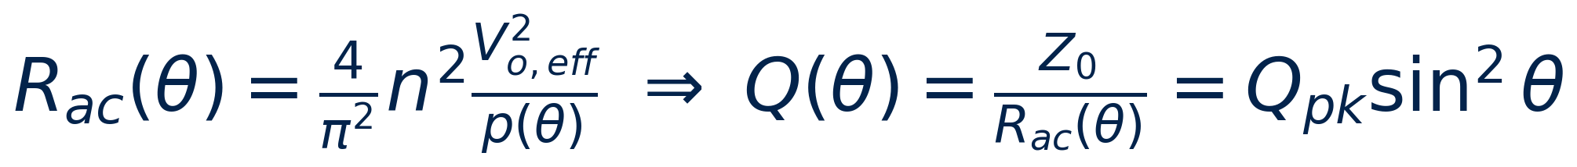
Step 5 · With M fixed, frequency buys you Q
and Q is nothing other than the load
Rac is inversely proportional to the power delivered, so Q is DIRECTLY proportional to it — commanding Q is commanding watts.
At each θ you know Mreq and you know the Q you want, so the gain equation has exactly one unknown left: fₙ. Solve it numerically.
TAKE THE LARGER ROOT — the smaller one is the capacitive region (hard switching, reversed gain slope, runaway loop). Repeat for every θ and you have the frequency trajectory the IC must follow across the line half cycle.
L6790A single-stage PF LLC

Slide 27
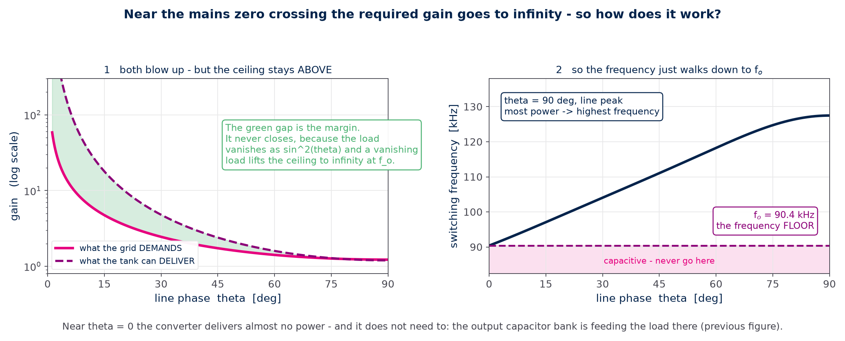
Step 6 · Why it never runs out of gain
The demand and the ceiling blow up at the same place
Near the zero crossing the required gain goes to infinity — which would be fatal if the load stayed on. It does not: the load vanishes as sin²θ, and with no load the gain ceiling itself becomes infinite at fₒ. Two divergences that cancel, so a solution exists at every phase. fₒ is the frequency FLOOR — keep the VCO clamp at or above it.
Figure: generated by figs.py from l6790.py
L6790A single-stage PF LLC

Slide 28
And where light load goes: burst mode
Below about a quarter load there is simply no continuous solution
As the load falls, Q falls, and the whole family of gain curves collapses onto the no-load curve. Its high-frequency asymptote is 1/(1+λ) — in this design 0.657.
Near the full-bridge morphing edge the REQUIRED gain is only 0.638. That is below the ceiling the converter can reach at any frequency.
So there is nothing to solve: the IC must stop switching for part of the time instead. That is burst mode, and it is STRUCTURAL here, not merely an efficiency option.
In this design the burst entry point lands at about 68.6 W in, i.e. roughly 28 % load. Everything below that is bursting.
Practical consequence: the 20 Hz voltage loop leaves 2fl ripple on the FB pin, and that ripple must not straddle the burst threshold or the converter chatters. Trim RBM.
Figure: onsemi / Fairchild AN-4151, Fig. 7
L6790A single-stage PF LLC

Slide 29
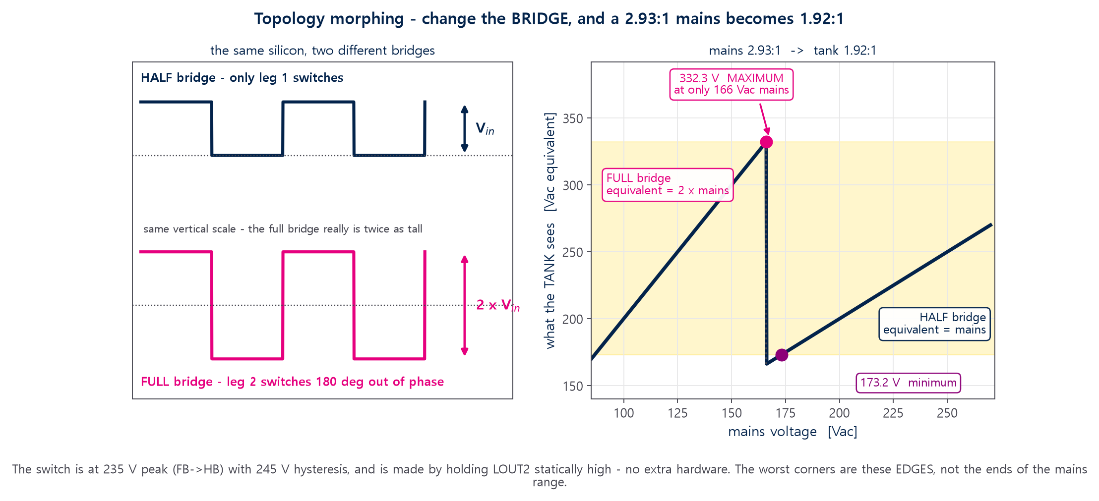
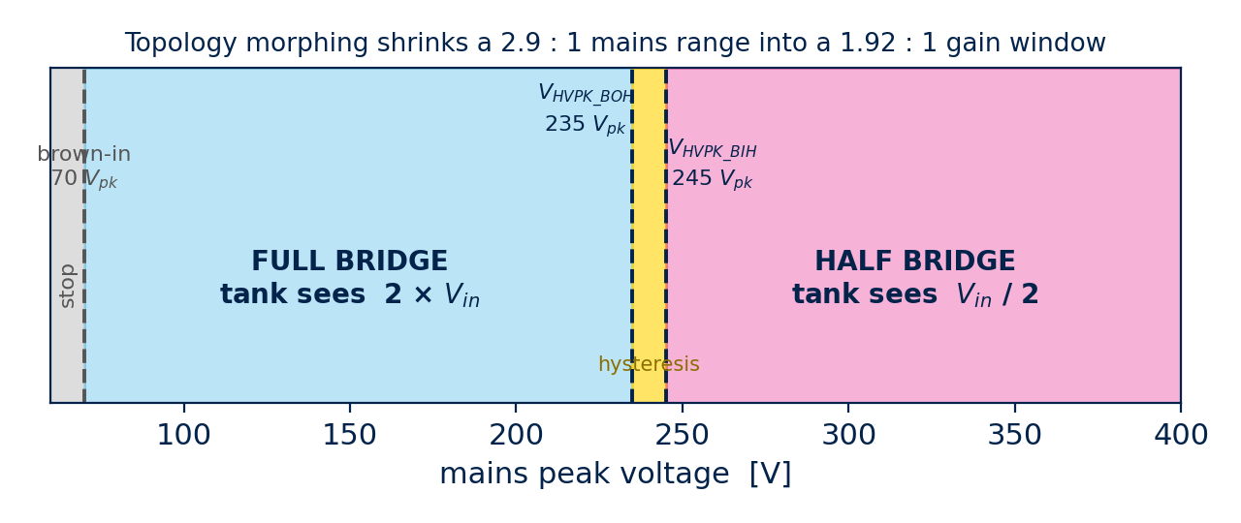
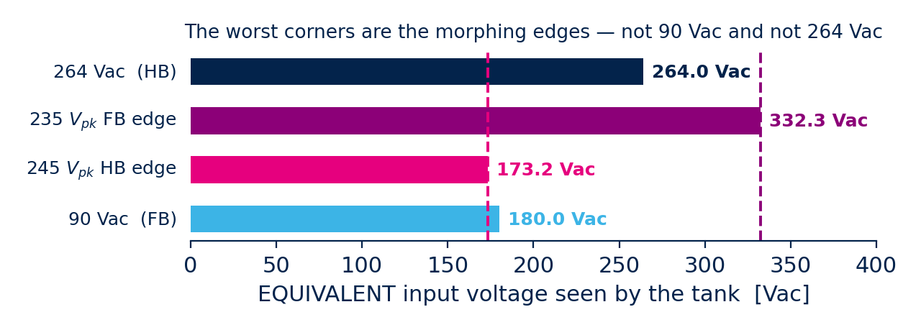


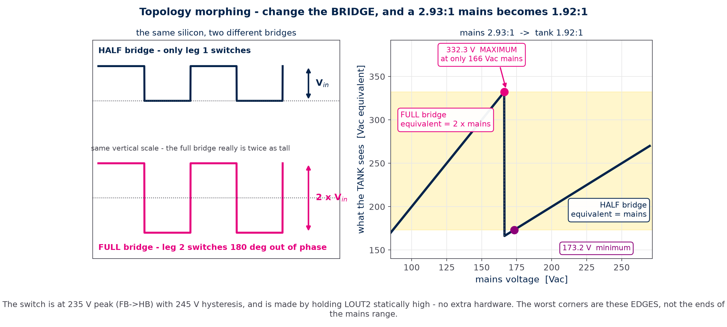
Topology morphing — why it exists
One tank cannot cover 2.93 : 1. So do not ask it to — change the bridge instead
The problem
A resonant tank has a usable gain
range of roughly 1.5 : 1 at full load.
The mains asks for 2.93 : 1
(90 to 264 Vac). No single tank
does that and still keeps ZVS.
The answer
Below 235 V peak run a FULL
bridge, which drives the tank with
twice the rail. Above 245 V peak
run a HALF bridge. The tank now
sees only 1.92 : 1.
It costs nothing in hardware — the same four switches, the same tank, the same control law. Only one gate signal changes.
Figure: generated by figs.py from l6790.py
L6790A single-stage PF LLC

Slide 30
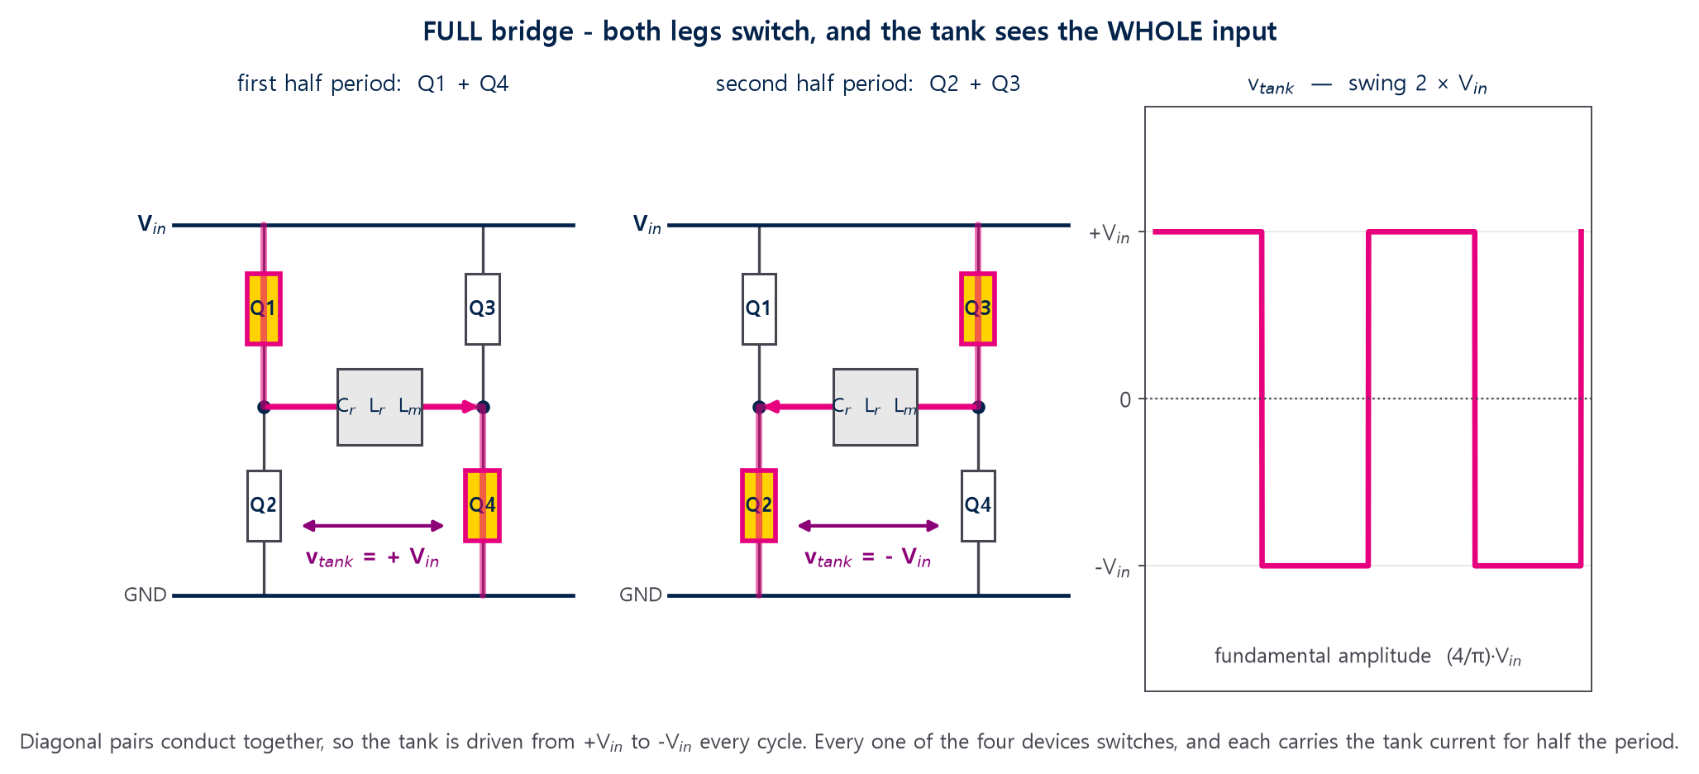
Full bridge — how the four switches drive the tank
Diagonal pairs conduct together, so the tank swings the whole rail
Why bother: at 90 Vac the tank would see only 90 V — far below what it needs to make 150 V of reflected output. The full bridge doubles it to 180 V, and low line becomes possible at all.
The cost: all four devices switch, so all four need ZVS, and each carries the tank current for half of every period.
Figure: generated by figs.py
L6790A single-stage PF LLC

Slide 31
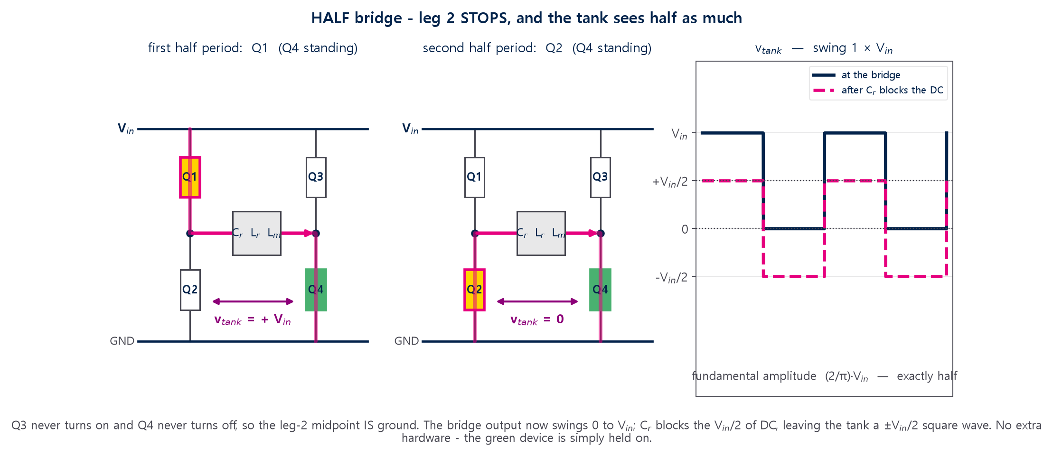
Half bridge — leg 2 stops, and Cᵣ does the rest
Q3 never turns on, Q4 never turns off. The tank sees half as much
Why it is not just "turn leg 2 off": with Q4 held ON the leg-2 midpoint becomes ground, so the tank still has a return path. Turning BOTH leg-2 devices off would simply open the circuit.
Watch the standing device: Q4 never switches, but it conducts the full tank current continuously — 10.9 A rms here, 9.62 W in one package. It is the hottest device in the converter.
Figure: generated by figs.py
L6790A single-stage PF LLC

Slide 32
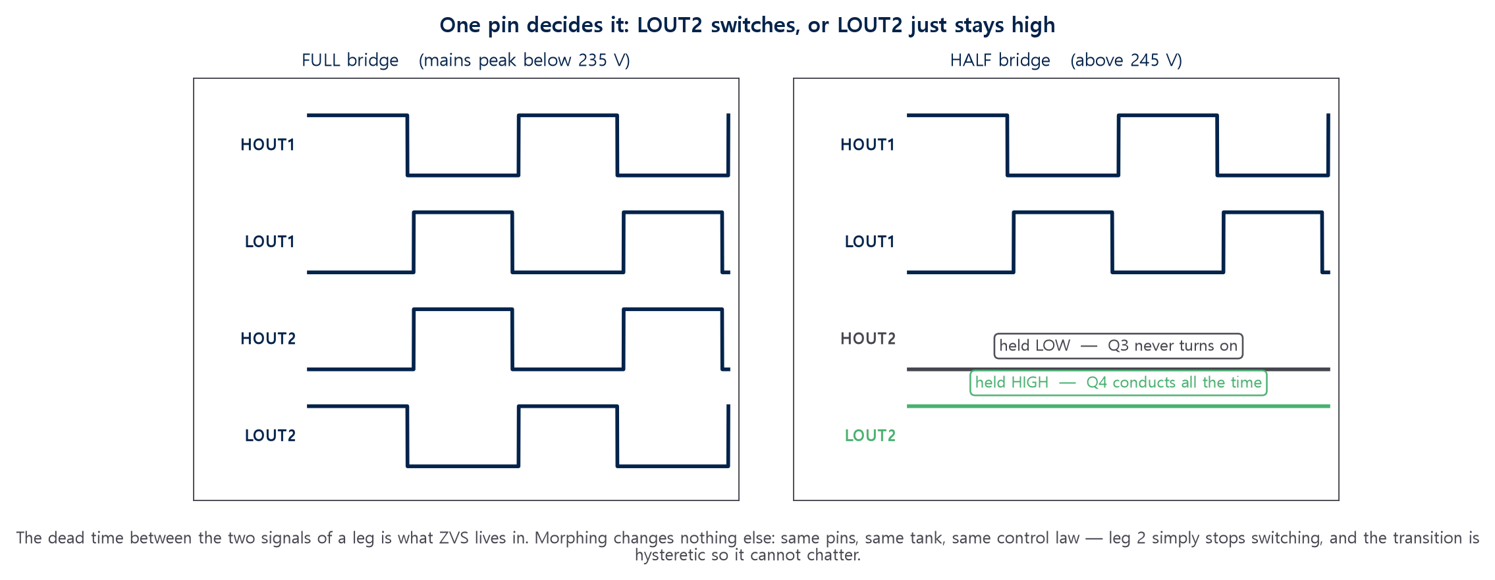
How the IC does it — one pin, no extra hardware
LOUT2 held statically high is the entire mechanism
Never load LOUT2
The pin sources 300 µA to strap the
configuration. Below ~8 kΩ to ground it
reads as fixed half bridge.
Cᵣ makes it work
The half bridge output has Vᵢₙ/2 of DC on
it. Cᵣ is already in series with the tank,
so it blocks that for free.
Hysteretic, so silent
235 Vₚₖ down, 245 Vₚₖ up. Ten volts of
hysteresis is what stops it chattering
at the threshold.
Figure: generated by figs.py
L6790A single-stage PF LLC

Slide 33
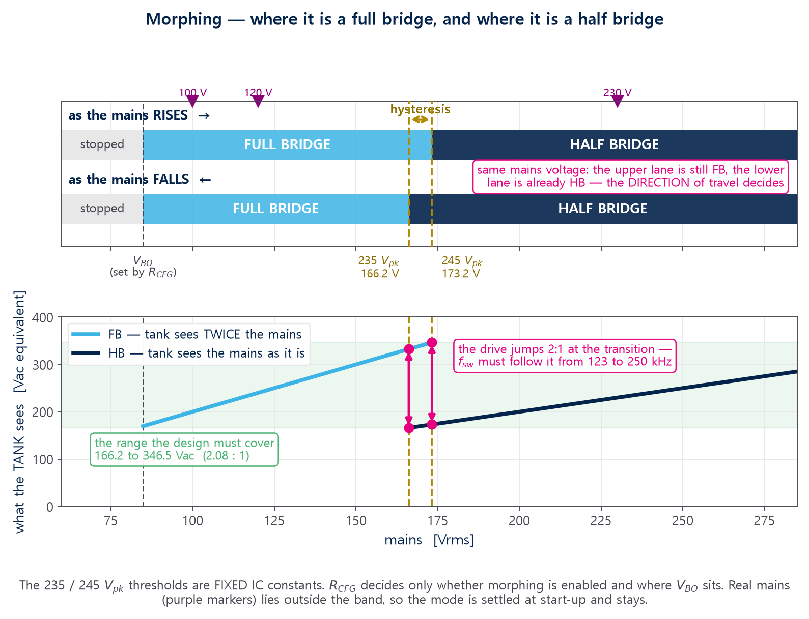
Where it changes — and the band in between
The thresholds are FIXED IC constants. R_CFG does not move them
Two worst corners, not two ends
The tank’s hardest points are the
morphing EDGES: 173.2 Vac equivalent
(worst gain and ZVS) and 332.3
(worst frequency). Neither is 90 or 264.
The band is a test condition
Real mains never sits at 166–173 Vrms,
so the mode settles at start-up. You
meet the band on an AC source, and
in line dip / surge tests.
⚠ Transition transient
The drive changes 2:1 in one line cycle
against a 17.6 Hz loop. Enveloped by
hold-up — but not yet checked in time.
Figure: generated by figs.py from l6790.py
L6790A single-stage PF LLC

Slide 34
The FB pin is a POWER command
Not an error voltage — a set point in watts
Substituting the datasheet burst-mode relations gives 0.167 V per Ω·W. Multiply by the 2.8 V feedback span and you get 16.8 Ω·W — exactly the maximum-power rule in the datasheet. The two are the same equation.
So the maximum power limit, the burst-mode entry point and the overload detection all sit on ONE scale: the FB voltage.
The external opto loop commands an INPUT POWER. The internal loop then distributes that power across the line cycle as sin²θ. That distribution is the PFC.
0.5 V
0.167 V/ΩW
16.8 Ω·W
FB offset Vos
power-to-FB gain
RCS × Pᵢₙ,max
L6790A single-stage PF LLC

Slide 35
PART 3
The L6790A
An analog controller that runs an LLC tank directly from the rectified mains, with PF = 1 and a THD optimiser — plus a full protection set.

Slide 36
L6790A at a glance
SO16N, 800 V start-up, logic-level outputs — external half-bridge drivers are mandatory
Pin | Name | Function — and the rule you must not break
1 | HVSU | 800 V start-up + mains sensing + X-cap discharge. Connect via two HV diodes AHEAD of the bridge, on the AC side.
3 | DRV_EN | Enables the external drivers; can also be pulled low to disable the IC. NO capacitor (sampled every 2 ms).
6 | ISEN | Negative current sense. Feeds OCP1/OCP2, anti-capacitive detection, adaptive dead time AND the max-power law. NO filter, NO series resistor.
7 / 8 | RT / CT | Oscillator. RT 5–30 kΩ, CT 270–1000 pF, RT·CT 2.5–12 µs. No capacitor on RT.
9 | FB | Opto collector direct. This is the power command (previous slide).
10 | BM | Burst-mode threshold, read once at power-up (pin strap). Tie to GND to disable burst. No capacitor.
11 | CFG | Brown-out level AND bridge configuration, read at power-up. Outside 15–100 kΩ the IC latches. No capacitor.
12 | ZCD | Auxiliary winding divider: output voltage sensing, OVP1/OVP2, demagnetisation. Polarity: ZCD must go POSITIVE when LOUT1 is on.
13–16 | LOUTx / HOUTx | Logic-level drive signals (VOH = 4 V). LOUT2 also selects half vs full bridge at start-up — never fit a pull-down.
L6790A single-stage PF LLC

Slide 37
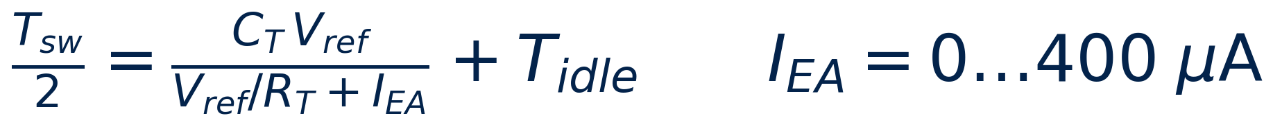
Configuration is a pin strap
RCFG plus the state of LOUT2 decide the whole operating scheme
Configuration | RCFG | LOUT2 | Input peak voltage | Mode
Morphing, fixed BIBO | 15 kΩ | OPEN | < 60 V / 70–235 V / > 245 V | stop / full bridge / half bridge
Morphing, adjusted BIBO | 15–47 kΩ | OPEN | < VBO / VBO+10…235 V / > 245 V | stop / full bridge / half bridge
Fixed full bridge | 47–100 kΩ | OPEN | < VBO / > VBO+10 V | stop / full bridge
Fixed half bridge | 15–100 kΩ | GND | < VBO / > VBO+10 V | stop / half bridge — SPLIT Cᵣ MANDATORY
The only actuator is IEA
The error amplifier current adds to the CT charging current. More current → higher frequency → LESS power. Everything else in the oscillator is fixed by RT, CT and Tidle.
VBO = RCFG × 4 V/kΩ. The datasheet quotes it as a PEAK value while the design tool and the EVL board notes quote rms — a factor √2 waiting to bite.
Watch Tidle
The datasheet is self-contradictory: 250, 350 or 700 ns depending on where you read. fMax swings by ±25 %. Keep it as a variable and measure it on the first board.
L6790A single-stage PF LLC

Slide 38
Protections
Two levels almost everywhere, so a fault degrades before it stops the converter
OCP1 / OCP2
ACP soft / hard
−550 mV / −750 mV on ISEN. Level 1 raises the frequency (folds power back); level 2 stops for 50 µs then restarts at the start-up frequency.
Anti-capacitive. Soft raises the frequency; hard stops for 50 µs. This is what keeps the tank out of the capacitive region.
OVP1 / OVP2
Brown-out / brown-in
2.3 V / 2.5 V on ZCD. Level 1 keeps switching with reduced power; level 2 stops for 100 ms and restarts with safe start.
40 ms debounce, 500 µs deglitch. Threshold set by RCFG.
Safe start / demag
X-cap discharge
Pulse and dead-time shaping during the first cycles so the bridge never hard-switches at start-up.
Discharges the EMI filter capacitors to a safe level when the mains is unplugged. Needs HVSU on the AC side.
FB / ZCD / ISEN open
Over-temperature
1 s time-out on FB, 14 ms on ZCD, 7 cycles on ISEN — the last two latch.
HVSU charge current is reduced until the junction cools.
L6790A single-stage PF LLC

Slide 39
PART 4
Side by side
The same eleven design steps — and every place where the single-stage answer is different.

Slide 40
Classic LLC vs single-stage PF LLC
Read this table twice. It is the whole point of the deck.
Topic | Classic LLC (behind a PFC) | Single-stage PF LLC (L6790A)
Input to the tank | pre-regulated 380–400 Vdc, nearly constant | rectified mains |v_ac(θ)|, 0 → 373 V, every 10 ms
What frequency controls | the OUTPUT VOLTAGE | the INPUT POWER — the voltage gain is forced
Design corner | full load, minimum bus (hold-up) | the two MORPHING EDGES: 173.2 and 332.3 Vac equivalent
m = Lp/Lr | 3 … 8 | 2.9 (λ ≈ 0.5, i.e. Lm ≈ 2 Lr)
Rac definition | 8n²Vₒ²/(π²Pₒ) | 4n²Vo,eff²/(π²Pᵢₙ) — defined at the LINE-PEAK power
Operating region | mostly at or just above fᵣ | mostly BELOW fᵣ; converges to fₒ at the zero crossing
Circulating current | moderate | large — the price of λ ≈ 0.5
Bulk storage | 400 V electrolytic bank at the input | moved to the OUTPUT; carries the full 2fl ripple current
Output ripple | tens of mV | a few % of Vₒᵤₜ at 100/120 Hz, by design
Voltage-loop crossing | kHz range | ~20 Hz — limited by the 3rd-harmonic (THD) budget
Burst mode | optional, for light-load efficiency | structural: below ~28 % load there is no continuous solution
L6790A single-stage PF LLC

Slide 41




Why λ has to be about 0.5
The classic rule of thumb will simply not start at low line
Four independent conditions each put a FLOOR under λ. You take the largest.
minimum gain at high line
maximum frequency
maximum frequency incl. dead time ← dominates here
minimum frequency
λ = 0.54 means m = 2.85 — well below the classic 3…8. Use the conventional Lm/Lr = 5…10 here and the converter simply will not start at low line.
L6790A single-stage PF LLC

Slide 42
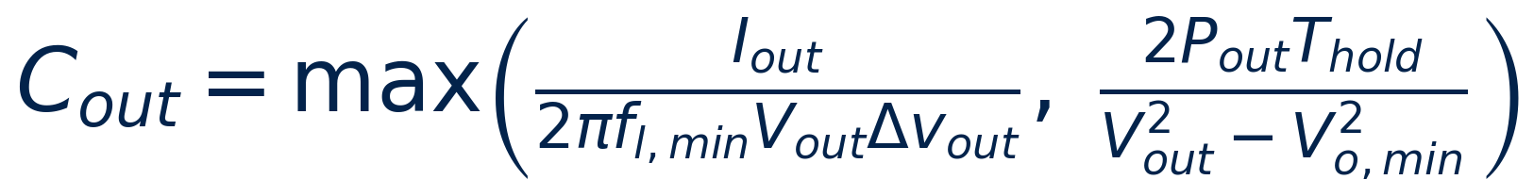
The output capacitor does two jobs now
Hold-up AND the whole 2fl energy buffer
Ripple condition
C ≥ Iₒᵤₜ /(2π fl,min Vₒᵤₜ Δv)
→ 71.2 mF (dominates)
Hold-up condition
Compute the ripple condition and the hold-up condition separately, and take the larger. WHICH ONE WINS is a question about the SPEC, not about the output voltage — both conditions go as 1/Vₒᵤₜ². Here ripple wins: 71.2 mF against 59.8 mF.
For the RMS ripple current you MUST include the 2fl component. Looking only at the switching-frequency component under-estimates it by about 40 %.
ESR must be the value at the SWITCHING frequency. An electrolytic tanδ is quoted at 120 Hz and is 5–10× larger there.
C ≥ 2 Pₒᵤₜ Thold /(Vₒᵤₜ² − Vo,min²)
→ 59.8 mF
Selected
470 µF × 160 = 75.2 mF, ESR 0.19 mΩ
ΔVₒ = 1.18 V (4.7 %), Thold = 13.4 ms
I_rms = 30.2 A (0.19 A per capacitor)
L6790A single-stage PF LLC

Slide 43
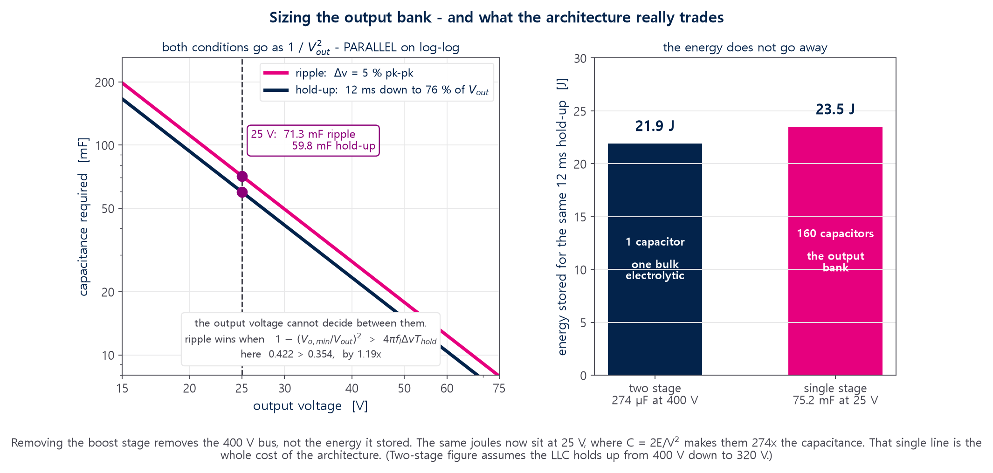
Which condition wins is a spec question
Both go as 1/Vₒᵤₜ² — so only Δv and the allowed droop can separate them
Read it as one inequality. The ripple condition asks for Pₒᵤₜ / (2π fₗ Δv Vₒᵤₜ²); the hold-up condition asks for 2 Pₒᵤₜ Thold / (Vₒᵤₜ² (1 − k²)) with k = Vₒ,ₘᵢₙ/Vₒᵤₜ. Divide them and Vₒᵤₜ cancels. A tight ripple limit and a generous droop allowance put ripple on top; loosen Δv to 10 % and hold-up takes over.
Figure: generated by figs.py from l6790.py
L6790A single-stage PF LLC

Slide 44
What 75 mF actually is, as hardware
160 capacitors — the single biggest item on the board, and a new risk with it
The count comes from capacitance, not current
75.2 mF / 470 µF = 160 parts. The bank
carries 30.2 A rms of ripple in total, which
is only 0.19 A each — comfortable. Nothing
here is current-limited; it is all farads.
ESR at the SWITCHING frequency
160 in parallel gives 0.1875 mΩ, and
17.4 mV of R&N. Use the ESR at fsw —
the tanδ on the data sheet is quoted at
120 Hz and is 5–10× larger there.
The 2fₗ term is most of the ripple current
Size the rms with the 2fₗ component in it.
Taking only the switching-frequency part
under-estimates by about 40 % — and on a
centre tap, judge it at the OUTPUT NODE.
⚠ Cold start is a NEW risk
The HVSU window is 120 ms. Charging
75 mF inside it has never been done on
this part — the 240 W reference had 4 mF,
eighteen times less. Measure it first.
And the part nobody costs: 160 electrolytics need board area, height and airflow. If the set cannot house them, the 25 V direct architecture is what has to change — not the capacitor.
L6790A single-stage PF LLC

Slide 45
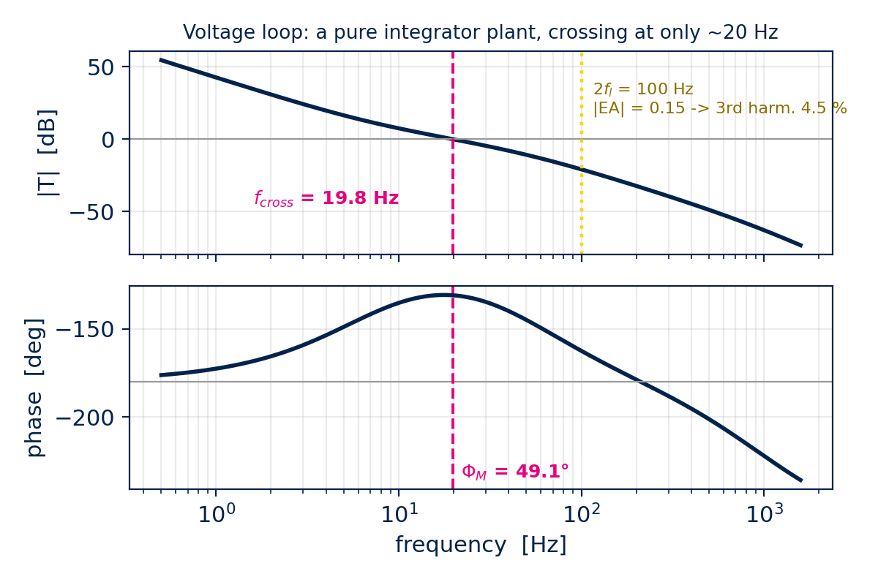

The voltage loop crosses at 17.6 Hz
A pure integrator plant, and a hard trade against THD
The output is a capacitor fed by a constant-power source, so the control-to-output transfer is a PURE INTEGRATOR: −90° at every frequency.
Any 2fl ripple that survives the loop and reaches FB becomes input-current distortion — mostly 3rd harmonic.
Raise the crossover and the ripple falls but the THD rises. The two constraints pull in opposite directions; the high teens is the practical compromise — 17.6 Hz here, for 4.2 % third harmonic.
A loop this slow cannot recover from a large load step. The datasheet anti-saturation circuit does that instead — which is why the opto bias resistor RB must be inside its window.
L6790A single-stage PF LLC

Slide 46
PART 5
Worked example
25 V / 26.3 A = 657.5 W, 90–264 Vac universal input, morphing enabled. Every number below is reproducible from the equations in Parts 2–4.

Slide 47
Step 1–3 Specification, power budget, equivalent input
Item | Symbol | Value
Input / output | Vac / Vₒᵤₜ , Pₒᵤₜ | 90–264 Vac / 25 V, 26.3 A (657.5 W)
Hold-up / minimum output | Thold / Vo,min | 12 ms / 19 V
Target series resonance | fᵣ | 150 kHz
Rectifier | Nrect | 1 (secondary centre tap, synchronous)
Dead time assumption | tD | 220 ns
LLC stage efficiency | η_HB | 98 %
Rated input power | Pᵢₙ | 684.77 W (η_tot = 96.02 %)
This is the step everyone gets wrong.
With morphing, the tank does NOT see 90 Vac at the bottom and 264 Vac at the top.
It sees 173.2 Vac equivalent at the half-bridge edge and 332.3 Vac equivalent at the full-bridge edge.
Equivalent range = 1.92 : 1 between the two design corners — 2.08 : 1 once the 235/245 Vpk hysteresis band is included. Miss this and you miss BOTH worst corners.
L6790A single-stage PF LLC

Slide 48
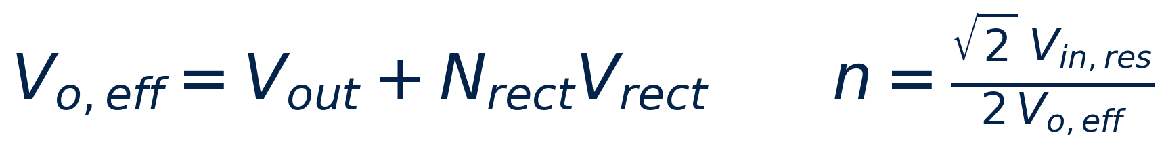
Step 4–6 Turns ratio, gain range, λ
n = 6
150 V
λ = 0.55
m = 2.82
equivalent-model turns ratio
reflected voltage n·Vo,eff
design inductance ratio
equivalent Lp / Lr
Always check the REFLECTED voltage, never the ratio alone
n only ever appears multiplied by Vo,eff. Same n·Vo,eff = same tank — but every CURRENT that uses n alone is then wrong.
Nᵣₑₑₜ = 1 here (centre tap), so the spreadsheet’s Nᵣₑₑₜ = 2 defect cannot arise. See Part 6.
L6790A single-stage PF LLC

Slide 49


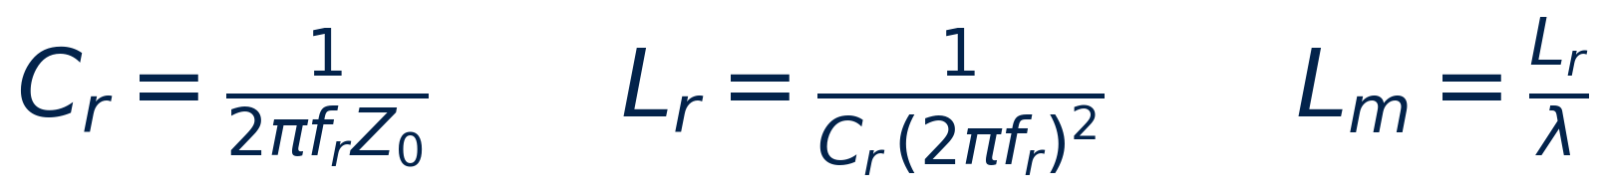
Step 7–8 Quality factor, ZVS check, tank components
Quantity | Calculated | Selected
Rac | 13.59 Ω | —
QZVS,1 / QZVS,2 | 0.974 / 6.97 | QZVS = 0.847
Z₀ | 11.51 Ω | —
Cᵣ | 92.21 nF | 100 nF ← rounded UP
Lᵣ | 11.26 µH | 11 µH
Lₘ | 20.32 µH | 20 µH ← rounded DOWN
λ_act / fᵣ / fₒ | — | 0.550 / 151.7 kHz / 90.4 kHz
Never round Lₘ UP. Here 20.3 µH was rounded DOWN to 20 µH, which keeps λ_act at 0.55; rounding up would have lowered it and taken the ZVS margin with it.
L6790A single-stage PF LLC

Slide 50

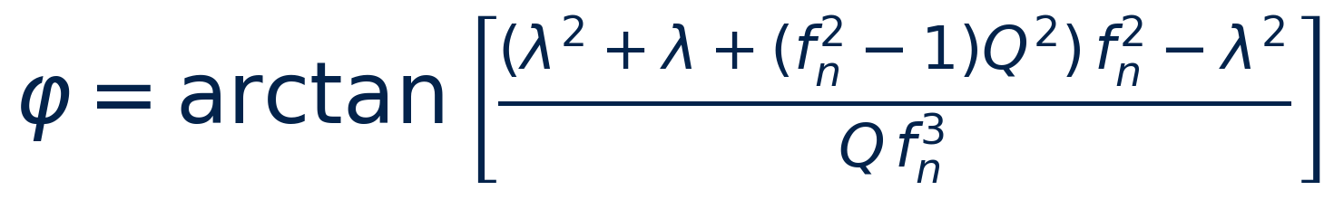
Step 9 ZVS verification at the REAL operating point
The closed-form short cut is wrong in BOTH directions — measure at the real operating point
Sweep θ, input voltage and load with the SELECTED tank, then take the minimum.
Worst point: full load, 173.2 Vac equivalent, θ = 90° → TZC = 457 ns.
Against tD = 220 ns that is 2.08× margin. Verified: the phase expression is EXACTLY the tank input-impedance phase, so the accuracy equals that of FHA itself.
The margin comes from the tank choice: Cᵣ was taken ABOVE its calculated value (92 → 100 nF) and Lₘ BELOW (20.3 → 20 µH), which lowers Q_pk and holds λ_act.
Measure ZVS at the morphing edge on the first board. No exceptions.
The [36]–[38] closed form has NO fixed sign. On this tank it UNDERSTATES the margin by 34 % (300 against the swept 457 ns); on a 240 W tank measured the same way it OVERSTATES by 23 % (302.8 against 246.5 ns). Two causes: [36] is a fitted approximation, and it is evaluated at the design Q_ZVS rather than the Q the converter actually runs at. Optimistic is the dangerous direction — it reports ZVS margin that is not there. Never trust it. Sweep.
Load | 173.2 | 180 | 225 | 264 | 332.3 Vac eq.
100 % | 457 ns | 515 | 669 | 672 | 603
75 % | 752 | 771 | 787 | 716 | 559
50 % | 1078 | 1073 | 964 | 802 | 497
25 % | 1464 | 1439 | 1223 | 965 | 394
L6790A single-stage PF LLC

Slide 51

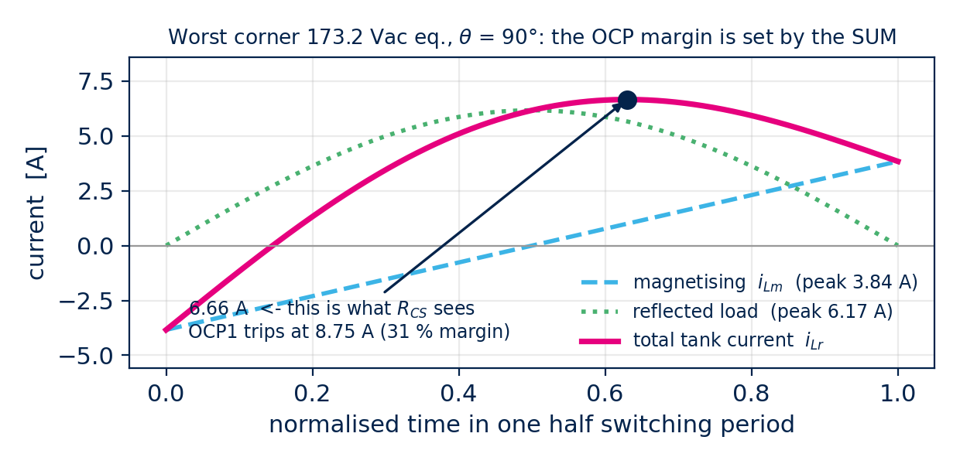
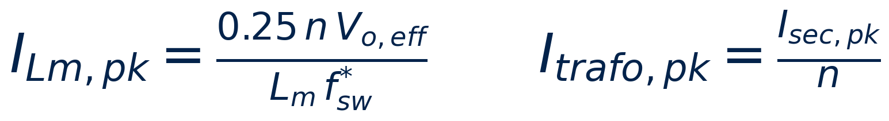
Step 10 Currents over the line cycle
Ratings come from the worst switching cycle; losses from the line-cycle rms
At 173.2 Vac eq., θ = 90° | Value
fsw | 127.5 kHz
Isec,pk | 98.36 A
Itrafo,pk / ILm,pk | 16.39 A / 12.36 A
composite tank peak | 18.32 A
Iₚᵣᵢ,rms / I_mos,rms | 13.75 A / 9.73 A
The conduction ratio √d matters: below resonance the secondary current flows only for d = fsw/fᵣ of each half period. Here d = 0.84, so ignoring it over-estimates the line-cycle rms by 12 %.
L6790A single-stage PF LLC

Slide 52
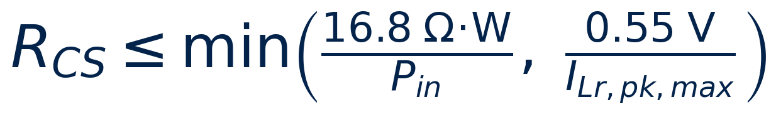
Step 11 IC network and component selection
Part | Value | Result
CT / RT | 470 pF / 11 kΩ | fMin 92.3 k, fMax 319.6 k
RCS | 24.0 mΩ (5 × 120 mΩ ‖) | Pᵢₙ,max 700 W; OCP1 22.9 A
RBM | 27.4 kΩ → 30 kΩ selected | burst entry 75 W in
RCFG | 30 kΩ | VBO 84.9 Vrms, morphing on
RZCD,H / L | 330 kΩ / 19 kΩ | OVP1 28.2 V, OVP2 30.6 V
Cᵢₙ | 2200 nF film | 3.2 nF/W — NO bulk capacitor
Cₒᵤₜ | 470 µF × 160 + 10 µF | ΔVₒ 1.18 V, R&N 17.4 mV
Primary switches | 600 V, 45 mΩ × 4 positions | full bridge (morphing), 1 device each
Secondary SR | 80 V, 3.7 mΩ × 2 per leg | leg carries 28.4 A rms
Compensation | 82 n / 560 n / 47 k / 1.55 n | fcross 17.6 Hz, Φ_M 49.6°
RCS is set by the LOWER of the two conditions. Here the maximum-power rule wins: 24.53 mΩ against 30.02 mΩ.
Judge the OCP margin against the COMPOSITE tank peak (18.32 A), not against Itrafo,pk (16.39 A). Using the load component alone overstates the margin.
fMin must sit at or above fₒ = 90.4 kHz, or nothing but the ACP protection stands between you and the capacitive region. RT = 11 kΩ puts it at 92.3 kHz — clear, but by only 2.1 %. That is the THINNEST margin in this whole design, and it moves with Tidle: at 700 ns it goes negative.
L6790A single-stage PF LLC

Slide 53
Sanity check against real silicon
The same procedure applied backwards to the EVL6790_670W evaluation board
Item | Fitted on the board | Recomputed with these equations | Board note
Cᵣ | 33 nF × 3 = 99 nF | fᵣ = 152.5 kHz | —
Lᵣ / Lₘ | 11 / 22 µH | λ = 0.500, fₒ = 88.1 kHz | matches
n / naux | 3.2 / 0.33 | equivalent 217 Vac design, centre-tap rectifier | matches
RCS | 68 ‖ 68 ‖ 75 mΩ | 23.4 mΩ → Pᵢₙ,max = 718 W | 670 W output
RCFG | 31 kΩ | 124 Vpk = 87.7 Vrms | VBO = 85 V
RBM | 24 kΩ | Pin,BM = 61.4 W → 55.3 W out | BMi = 55 W
ZCD divider | 150 k / 23 kΩ | OVP1 52.4 V, OVP2 57.0 V | 52 V / 57 V
Cₒᵤₜ | 4700 µF × 4 = 18.8 mF | hold-up 10 ms, 48 → 40 V needs 19.0 mF | —
It closes
Note the λ
Every fitted value falls out of the same equations, including the two annotations the ST designers wrote on the schematic (BMi = 55 W and VBO = 85 V).
The board runs λ = 0.500, essentially the same as our 0.55. That is the strongest single confirmation that λ ≈ 0.5 is structural, not a quirk of our
L6790A single-stage PF LLC

Slide 54
PART 6
Verification and errata
Every one of the 148 design equations was re-implemented independently and cross-checked against waveform integration and impedance analysis. Here is what came out.

Slide 55
What was verified, and how
All 148 equations re-derived
FHA solved at the real operating point
Independent second implementation (l6790.py). Every worksheet build re-checks it term by term and refuses to write on any mismatch.
θ, input voltage and load swept over the whole range with the SELECTED tank, instead of the closed-form short cut.
Phase expression proved exact
Waveforms integrated numerically
The φ formula is identical to the tank input-impedance phase to 1e−16. So TZC is as accurate as FHA itself.
Confirms Isec,pk is exact, the √d correction on the rms is exact for fsw ≤ fᵣ, and the composite tank peak matches the true maximum.
Loop closed numerically
Board back-calculated
fcross = 17.57 Hz, Φ_M = 49.64°, 3rd harmonic 4.23 % — all as printed. Gain margin: f180 = sqrt(fp*fpx − fz*(fp+fpx)) in closed form.
EVL6790_670W reproduced from the same equations, including the designer annotations. Workbook vs SMath sheet: 145 quantities, 0 unexplained differences.
L6790A single-stage PF LLC

Slide 56
Findings — design tool r1.0
Corrected copies of the spreadsheet and the SMath sheet accompany this deck
Where | What is wrong | Effect
Res.Tank D9 (+ the whole RTC grid) | Vo,eff divided by Nrect a second time, so n is doubled when Nrect = 2 | n comes out DOUBLED. Wind that and the required gain doubles — no start-up at low line. The tank values themselves are unaffected. This design uses Nrect = 1, so it cannot arise here.
Design Spec D20 / D79 | Equivalent input range taken as 165–180 and 264 Vac | Both morphing corners missed. The sheet stops at 264 Vac and reports 189.2 kHz; the real FB corner is 332.3 Vac equivalent and 249.6 kHz
Device Setting D3 | fsw,max,design = MIN(spec, 1.5·fₒp) — the outer MAX is missing | The oscillator can be sized for a ceiling BELOW the real operating point
Res.Tank D35 | IR1,pk uses the average power instead of the line-peak power | Exactly half; under-states the ZVS current
CC C25/D25/E25 | Secondary rms has no √d conduction-ratio term (row 31 does have it) | Up to 12 % over-estimate — and inconsistent inside one sheet
CC C31 | Output-capacitor rms holds only the switching-frequency part at one θ | About 40 % low — the 2fl component is the larger one and it is missing
Device Setting D83 | (naux/nsec)max divided by Nrect while V_aux,OVP2 is not | Twice as permissive; a legal-looking choice can exceed the VCC rating
Comp D15 / D43 | CTR applied twice to IFB,max | The whole RB window moves; the value it lands on is outside it
Prelim D17 | labelled η_HB but computes η_rect·η_HB | identical only while Vrect = 0
L6790A single-stage PF LLC

Slide 57
Findings — design tool r1.0 (2/2)
Found after rev 1.1 — compensation check, the ISEN block, and one approximation that is not labelled as one
Where | What is wrong | Effect
CN H132/H134/H139, bisection H141:N167 | the high-frequency pole f_px is absent from the loop check | phase 0.8–1.1° optimistic near crossover
CN D73 (and D125) | labelled "@2fL,min" but divides by the ripple at NOMINAL fl; D68 computes the fl,min ripple and is never referenced | 1.064x optimistic; propagates into EA_o, f_MB, f_z, C_Fo and R_F
Device Setting D39 | R_CS,max2 divided by I_trafo,pk — the load component only | R_CS sees the COMPOSITE tank peak. 1.10x optimistic
Device Setting D45 | labelled "Select…" but is a formula that hard-codes the EVL board network 220‖220‖220‖440 | R_CS never moves, whatever the spec. And it may violate D44 with no warning
Device Setting D33 | R_CS loss current is CC!C29, a single θ = π/4 sample | neither the line-cycle rms nor the worst switching cycle. 3 parts sized where 5 are needed
nowhere in the workbook | the OCP trip point is never computed — no 0.75 V, no "OCP" anywhere | a sense resistor that trips OCP continuously can pass every check in the sheet
CC C25/C26/C29/C30 used as "mains cycle" | θ = π/4 sampled once; exact only if the envelope were sin θ, and it is sin²θ | I_diode 17.6 % low → rectifier loss 1.38x low → required Rth 12.6 → 9.1 °C/W
Res.Tank D20 QZVS.3 | a third Q limit is computed and then discarded; eq [34] uses only two | not a real limit - the FHA ceiling clears the requirement by 15.6 % and the ZVS sweep by 108 %. Applying it would cut Q by 3 % for nothing
Device Setting D24 "RT.min" | f_Min FALLS as R_T rises, so this is a CEILING, not a floor | read literally you round R_T up and push the VCO clamp below f_o - the one thing rule 3 forbids
R_P selection (tool, sheet AND this deck) | R_P,max = V_F/I_min = 1.4375 k was rounded UP to 1.5 k | shunt regulator sits at 0.767 mA against its 0.8 mA minimum. A MAXIMUM rounds DOWN
five limit/selection pairs | C_T, R_T, n_aux/n_sec, R_P and C_in all have a computed limit and no cell comparing it with the selection | a violation passes silently - exactly the C.15 shape. Ratio cells added on both sides
L6790A single-stage PF LLC

Slide 58
Findings — datasheet and SMath sheet
The datasheet is still a DRAFT; treat these as open items
Item | Issue | What to do
Tidle | §5.3.2 implies 700 ns in one equation and 350 ns in another; all EIGHT cells of the Table 5 fosc range reverse-calculate to 250 ns within 0.2 ns | Evidence favours 250 ns. Until measured: check margins at 700 ns, predict performance at 250 ns. Every oscillator constant hangs on it.
VBO | written as min(60 V, RCFG·4 V/kΩ), which would give 60 V for every legal RCFG | Read it as RCFG·4 with 15 kΩ as the floor. Also: datasheet peak vs tool/board rms — a √2 trap.
RZCD,L formula §5.3.4 | dimensionally A⁻¹, not Ω; gives 95.7 kΩ and a 24 µA divider current | Use RZCD,L = V_OVP1,th / I_bias. The EVL board fits exactly that.
SMath as-built ZVS re-check | used the DESIGN λ with the AS-BUILT Q | WITHDRAWN 2026-08-24: the closed form has no fixed sign at all. It is now used nowhere — the sweep [38a] is the only ZVS check.
SMath summary annotations | still carried rev 0.2 numbers (Q 0.9298, Z₀ 34.62 Ω, TZC 275.8 ns) | FIXED, and every input now carries a real SMath unit
Guide [125]/[130] | G_o and EA_o labelled "Hz" but they are rad/s | Cosmetic, but fcross = G_o/2π only makes sense in rad/s
Guide [134]/[135] | CF and RF examples are computed from the SELECTED CFo, not the calculated one | State it explicitly, as [96] already does for RZCD
DS §5.3.1 LOUT1 / LOUT2 | the text says "a strong pull down on LOUT1", but Table 6 and the actual pin strap are LOUT2 — the EVL board leaves the LOUT2 pull-down unfitted | Read it as LOUT2. A pull-down on LOUT1 breaks something else entirely.
L6790A single-stage PF LLC

Slide 59
Measure these first
The eight things that will decide whether the board works
1
ZVS at the HB morphing edge
245 Vpk, full load. Calculated TZC = 457 ns against tD = 220 ns — the worst point anywhere. Look at the gate and midpoint waveforms directly.
2
fsw at the FB morphing edge
235 Vpk, full load. Calculated 249.6 kHz. The VCO ceiling is 319.6 kHz at Tidle = 250 ns, but only ~252 kHz at 700 ns — level with the requirement.
3
fsw(θ) over a line half cycle
Confirms Tidle and the margin against the fₒ floor.
4
Input current and THD at 90 Vac full load
Quantifies the zero-crossing dead zone.
5
Cold start-up
Can a millifarad output bank be charged inside the 120 ms HVSU window?
6
FB ripple against the burst threshold
A 20 Hz loop leaves 2fl ripple on FB. Trim RBM if it chatters.
7
Output ripple and OLED luminance
1.18 V pk-pk at 2fl on a 25 V rail. This is what decides whether the direct 25 V architecture is acceptable at all.
8
Adaptive dead time
Does it really settle at or below 220 ns at the worst corner?
L6790A single-stage PF LLC

Slide 60
Sixteen rules to take away
If you remember nothing else from this deck, remember these
1.
Design the tank at the real ends of the EQUIVALENT input range. With morphing that is 173.2 and 332.3 Vac, not 90 and 264.
2.
Expect λ ≈ 0.5. The classic Lₘ/Lᵣ = 5…9 will not start at low line.
3.
Keep the VCO minimum clamp at or above fₒ. Do not rely on the anti-capacitive protection alone.
4.
Size the output bank from ripple AND hold-up, take the larger, then check the RMS ripple current.
5.
The voltage loop crosses near 20 Hz; manage the leftover FB ripple with Rʙᴍ.
6.
Measure both morphing edges. HB edge = worst gain and ZVS; FB edge = worst frequency.
7.
Always verify the turns ratio through the REFLECTED voltage n·Vo,eff.
8.
Judge on the COMPOSITE tank peak — OCP margin and primary device rating both. Then divide by the parallel count: the tables are per POSITION and per LEG.
9.
Include the 2fₗ component in the output-capacitor ripple current — it is about 40 % of it.
10.
Apply the √d conduction ratio to the secondary rms when fₛᴡ < fᵣ.
11.
Decide first whether Lᵣ is a discrete inductor or transformer leakage; that decides the magnetics.
12.
Take every datasheet number at the REAL condition: ESR at fₛᴡ not the 120 Hz tanδ, Rᴅꜱ(ₒₙ) at Tj,max not the 25 °C headline (≈2×), and Co(tr)/Qoss for ZVS not the headline Coss (3–5× apart).
13.
Never round Lₘ up. λ_act falls and the ZVS margin goes with it.
14.
Do the final ZVS check at the REAL operating point. The closed-form short cut has NO fixed sign — +23 % on one tank, −34 % on another.
15.
Choose a primary MOSFET whose BODY DIODE recovers fast. Overload, load steps and start-up all leave resonance, and there the diode decides whether you lose watts or the device.
16.
Take fₛᴡ,max from the FB morphing edge, not from the maximum mains. The oscillator ceiling and Cₜ follow from it.
Rules 15 and 16 are new in this revision.
Rule 15 after ROHM TechWeb, "Importance of the Recovery Characteristics of Primary-side Switching Elements"
L6790A single-stage PF LLC

Slide 61
Our technology
starts with You
Accompanying files: corrected design spreadsheet (CHANGELOG_rev0_6 sheet) · SMath worksheet with SI units · design guide rev 0.6
This deck is a study document. The L6790A datasheet is a DRAFT — re-verify against the released datasheet before any production design.

